Slide 1
ADVANCING COSMETIC INNOVATIONS THROUGH ORGANIC BIOMASS: A WEB APPLICATION FOR EFFICIENT BIOMASS CONVERSION INTO SUSTAINABLE FORMULATIONS
Done by
Team members : MADHESHWARAN M
Reg. No.:912321104019
VISHWA M
Reg. No.: 912321104053
RAMACHANDRAN V
Reg. No.: 912321104036
IV-Year, CSE
Guide Name : Mrs. A. Judith Arockia Gladies, (AP/CSE)

Slide 2
ABSTRACT
This project introduces a web application designed to manage and repurpose hair waste from salons into sustainable beauty and hair care products. Salons generate substantial hair waste, which often contributes to environmental pollution. Our system provides a digital platform for tracking, processing, and analyzing hair waste based on melanin and keratin content—key components in enhancing hair care formulations. By leveraging machine learning and a decision tree algorithm, the application optimizes extraction methods, ensuring high-quality product development. Additionally, it facilitates seamless communication between salons and manufacturers while generating insightful reports for informed decision-making. This innovation bridges the gap between waste management and technology, promoting sustainability in the beauty industry. Future enhancements include refining extraction techniques, scaling operations, and exploring broader applications of hair-derived materials.

Slide 3
DOMAIN-INTRODUCTION
Machine learning plays a crucial role in optimizing the extraction process of hair waste by analyzing its composition (melanin and keratin content).
The decision tree algorithm helps determine the most efficient extraction methods for developing high-quality sustainable beauty and hair care products.
Additionally, machine learning enhances the system by:
Automating the classification of hair waste based on its biochemical properties.
Improving decision-making in processing and repurposing waste.
Generating insights for salons and manufacturers to streamline operations.
Reducing environmental impact by maximizing resource utilization.

Slide 4
Literature Survey

Slide 5
Title | year | Author(s) | Methodology | Disadvantages
Communication-efficient learning of deep networks from decentralized Data | 2017 | B.McMahan, E.Moore, D.Ramage, S. Hampson, and B. A .Y . Arcas | Methods include model compression, gradient sparsification, federated averaging, and adaptive communication. Techniques like knowledge distillation and gradient-free methods further optimize decentralized learning efficiency. | Loss of Model Accuracy Increased Computation on Devices Delayed Convergence
Federated learning of predictive models from federated electronic health records | 2018 | T. S. Brisimi, R. Chen, T. Mela, A. Olshevsky, I. C. Paschalidis, and W. Shi | Federated learning enhances privacy by training models locally and aggregating updates. Methods include FedAvg, personalized learning, and secure learning with encryption. Communication-efficient techniques and heterogeneous data handling improve scalability and performance. | High Communication Costs Non-IID Data Challenges Security Risks Device Heterogeneity

Slide 6
Title | year | Author(s) | Methodology | Disadvantages
Federated learning in smart city sensing: Challenges and opportunities | 2020 | J. C. Jiang, B. Kantarci, S. Oktug, and T. Soyata, | Smart city federated learning leverages edge computing, secure aggregation, and communication-efficient techniques. Adaptive learning and multi-modal fusion enhance real-time urban sensing and decision-making | High Communication Overhead Non-Uniform Data Distribution Security Vulnerabilities
Advances and open problems in federated learning | 2021 | P. Kairouz | Federated learning enhances privacy by training models locally and aggregating updates. Methods include FedAvg, personalized learning, and secure learning with encryption. Communication-efficient techniques and heterogeneous data handling improve scalability and performance | High Communication Costs Non-IID Data Challenges. Security Risks

Slide 7
EXISTING SYSTEM
Current Extraction Sources: Melanin is typically derived from fungi, cuttlefish ink, and bacteria, while keratin comes from animal-based sources like feathers and wool.
Lack of Structured Salon Waste Management: No comprehensive system exists to track and manage hair waste extraction in salons.
Environmental Concerns: Inefficient handling of salon waste contributes to pollution and resource wastage.
Need for a Digital Solution: A web application can help salons log, track, and manage hair waste efficiently.
Optimized Extraction Process: Smart technologies would enhance melanin and keratin extraction from hair waste, reducing reliance on animal and microbial sources.

Slide 8
EXISTING SYSTEM(CONT)
Real-Time Monitoring: The system allows users to track hair collection, extraction effectiveness, and waste conversion into beauty products.
Improved Sustainability: Digital management of waste promotes eco-friendly practices in the beauty industry.
Data-Driven Decision Making: The app generates reports to help salons optimize waste management and enhance product quality.
Seamless Salon-Manufacturer Collaboration: Enables direct communication and transactions between salons and product manufacturers.
Reduced Industry Footprint: By repurposing hair waste, the system contributes to a more sustainable and circular beauty economy.

Slide 9
PROPOSED SYSTEM
Sustainable Hair Waste Management: Enables salons to efficiently collect and repurpose hair waste into valuable products like sunscreens and hair care items.
Melanin & Keratin Extraction: Processes collected hair to extract essential components for high-quality beauty formulations.
Salon Data Management: Allows salon owners to log hair waste details, track approvals, and monitor contributions in real time.
Payment & Transaction Tracking: Facilitates secure payments for salons based on the quantity and quality of hair waste provided.
Quality Assessment & Reporting: Employees can evaluate hair quality, measure melanin and keratin levels, and submit detailed reports.

Slide 10
PROPOSED SYSTEM(CONT)
Admin Oversight & Control: Admins manage salon registrations, approve contributions, oversee product processing, and ensure smooth system operations.
Real-Time Monitoring: Keeps all stakeholders informed with up-to-date tracking of hair collection, processing, and product development.
Secure & Transparent Data Storage: Ensures all records are securely stored, maintaining transparency and accountability.
User-Friendly Interface: Simplifies navigation for salons, employees, and admins to enhance efficiency and usability.
Eco-Friendly Innovation: Promotes sustainability by integrating technology with waste management, reducing environmental impact.

Slide 11
PROPOSED SYSTEM (ADVANTAGES)
Reduces Waste & Pollution: Hair waste that would usually go to landfills or be burned is now used for making products, which helps reduce waste and pollution.
Lower Greenhouse Gas Emissions: The process can reduce the greenhouse gases typically released during regular sunscreen production, making it more eco-friendly.
Natural UV Protection: Melanin extracted from hair provides natural UV protection, reducing the need for chemical UV filters that may have health risks.
Supports Local Communities: Involving salons in hair waste collection helps build local partnerships and creates new economic opportunities for communities.

Slide 12
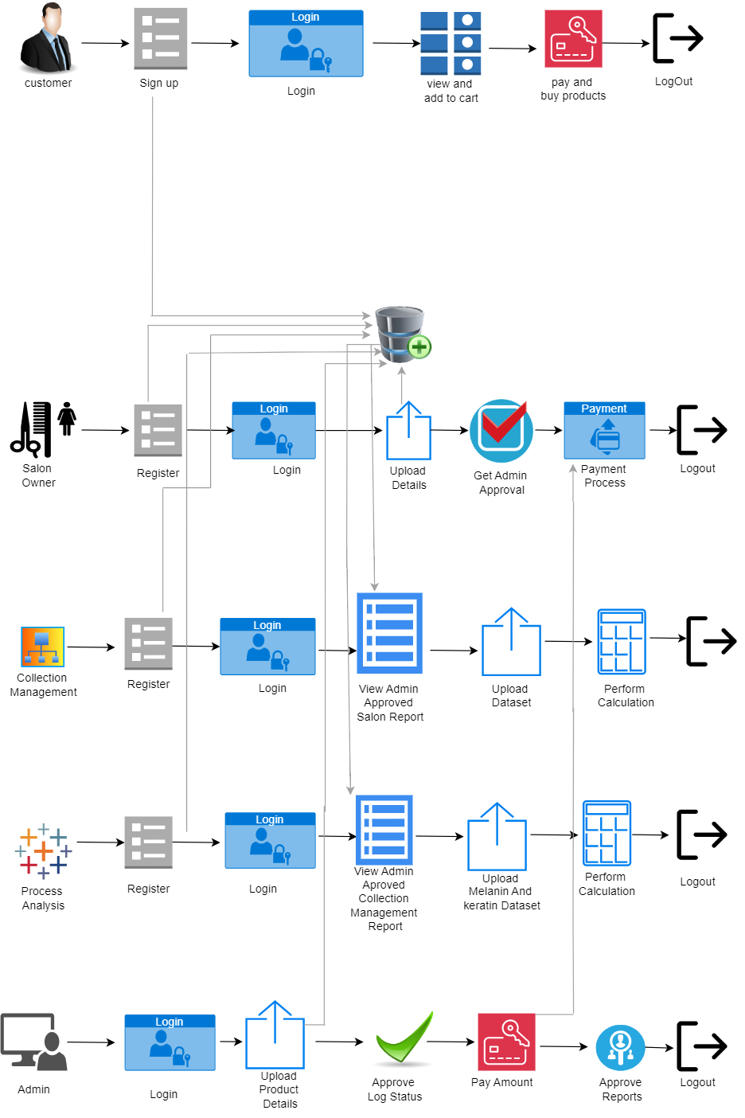
OVER ALL VIEW

Slide 13
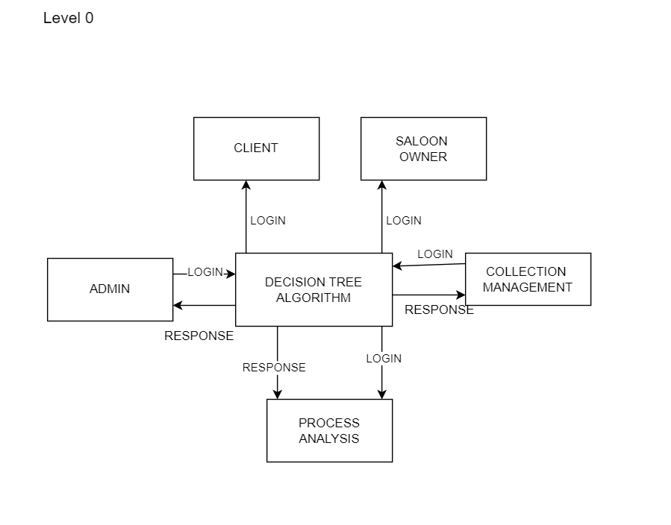
MODULE FLOW DIAGRAM

Slide 14
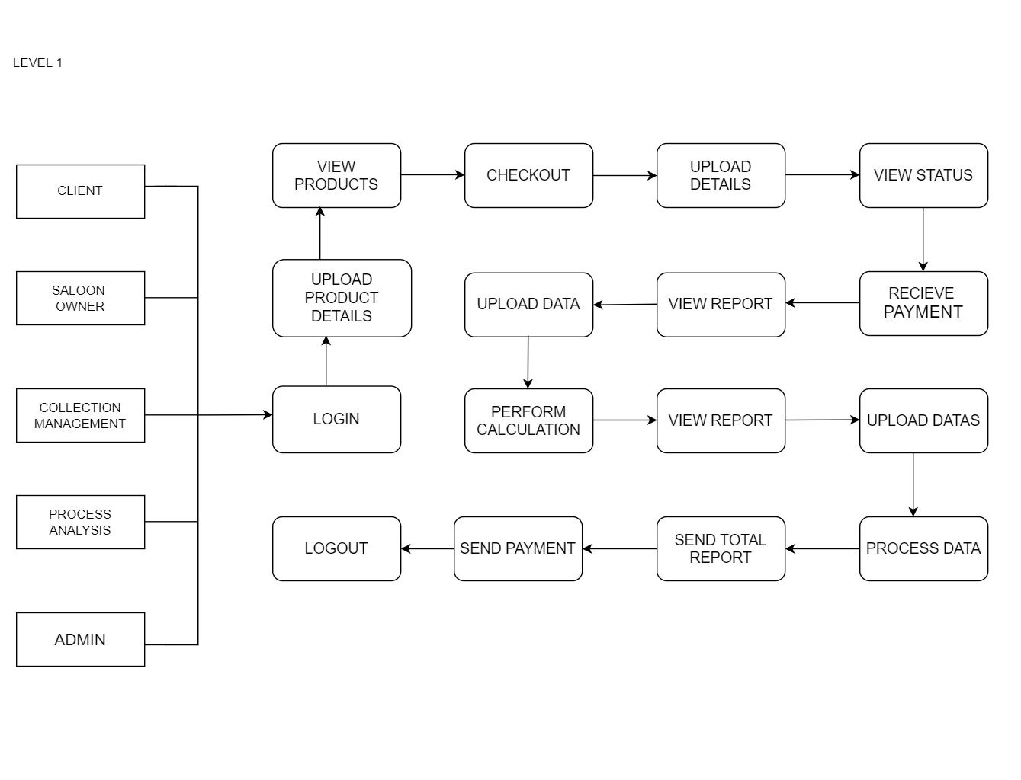
LIST OF MODULES

Slide 15
MODULE 1: CLIENT
Secure Login & Registration – Clients can create an account and log in using their credentials to access personalized features.
Product Catalog Browsing – Users can explore a list of products with descriptions, prices, and features.
Cart Management – Clients can add items to the cart, update quantities, or remove products before checkout.
Smooth Checkout Process – Ensures users enter payment and delivery details before confirming the order.
Order Confirmation & Logout – After successful checkout, a unique order ID is generated, and clients can securely log out.

Slide 16
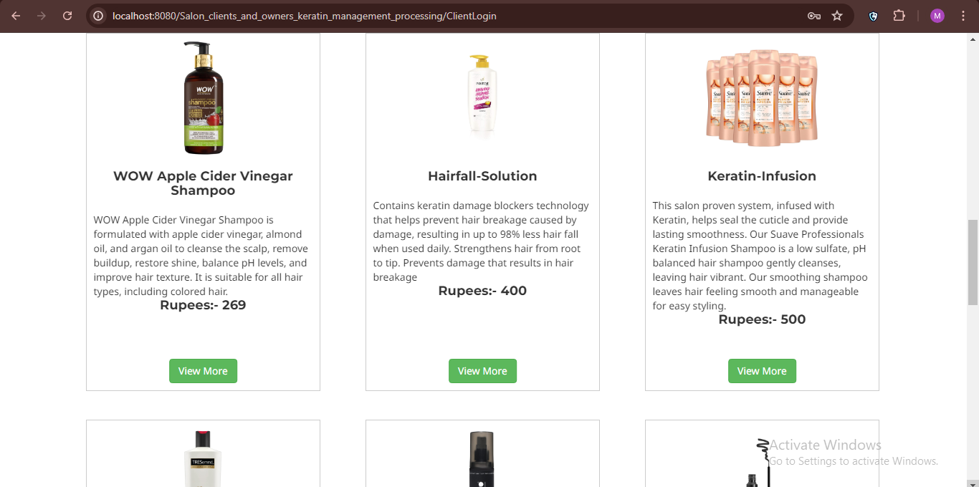
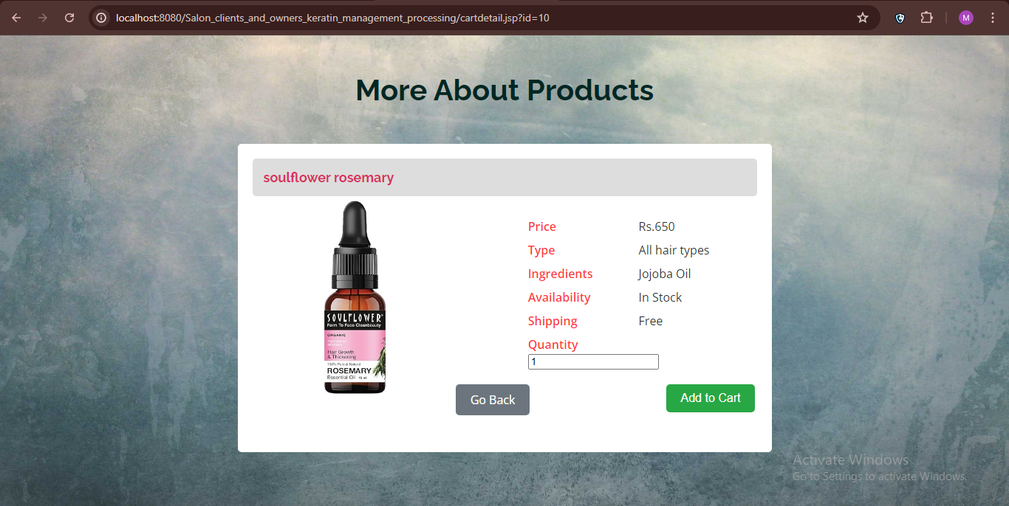
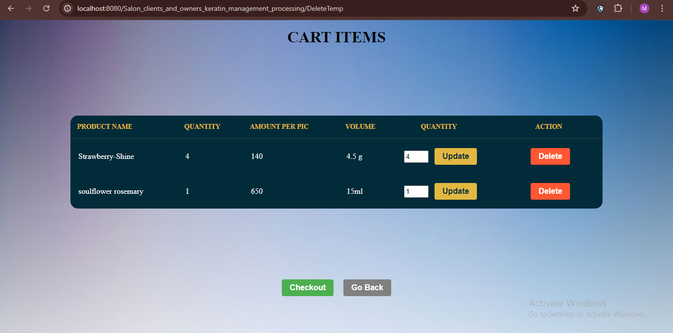
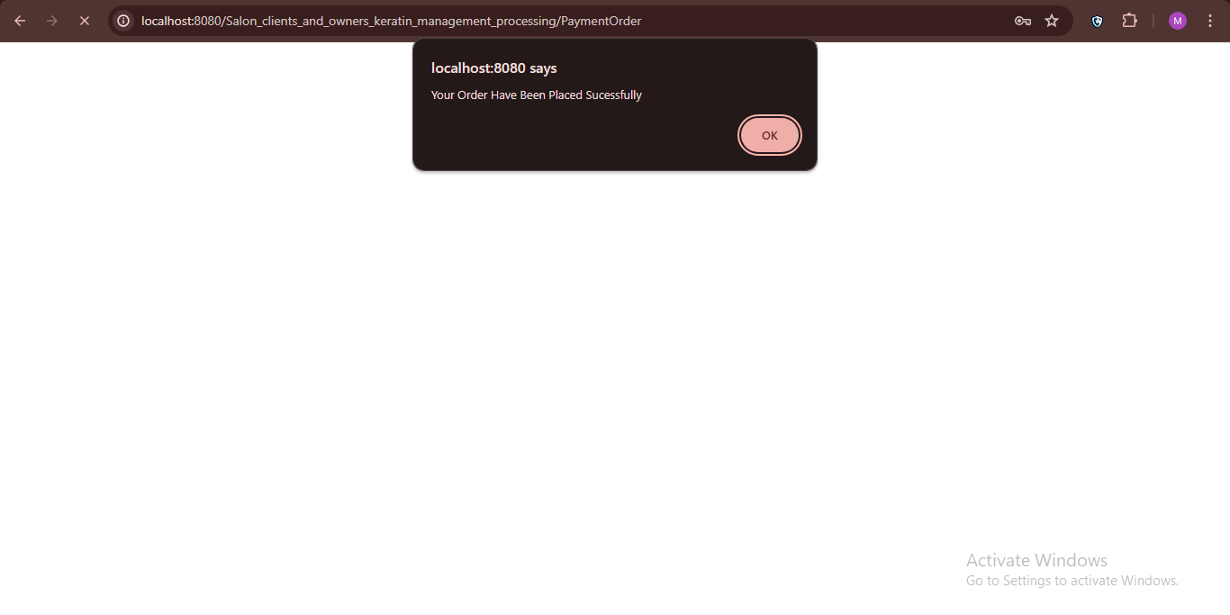
MODULE 1: CLIENT OUTPUT

Slide 17
MODULE 2: SALON OWNER
Salon Owner Registration – Owners sign up by providing personal and shop details and receive an admin-approved password.
Data Upload – Owners can submit information about hair collection, services provided, and other relevant details.
Approval Status Tracking – Owners can check if their submitted data is approved or rejected by the admin.
Bank Details & Payment Processing – If approved, owners register their bank details to enable smooth payment transactions.
Payment & Logout – Owners can track payment status and securely log out after completing all steps.

Slide 18
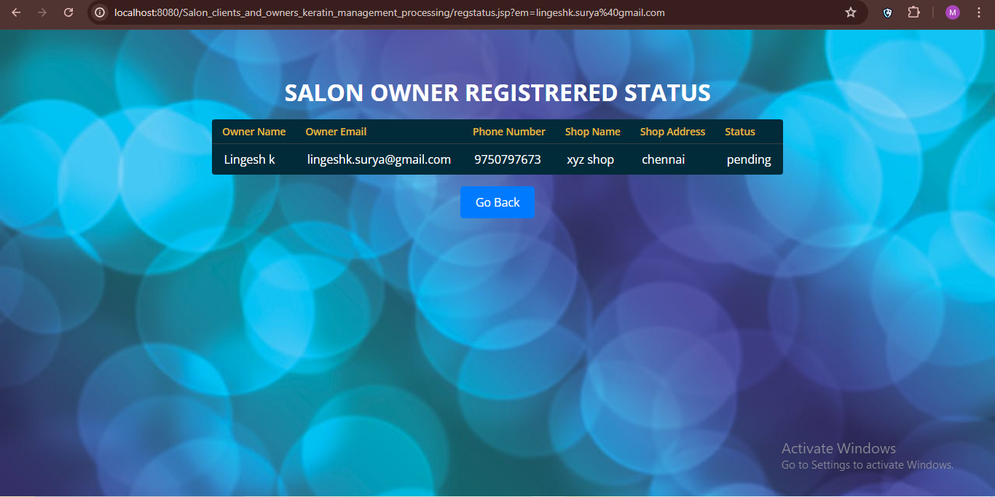
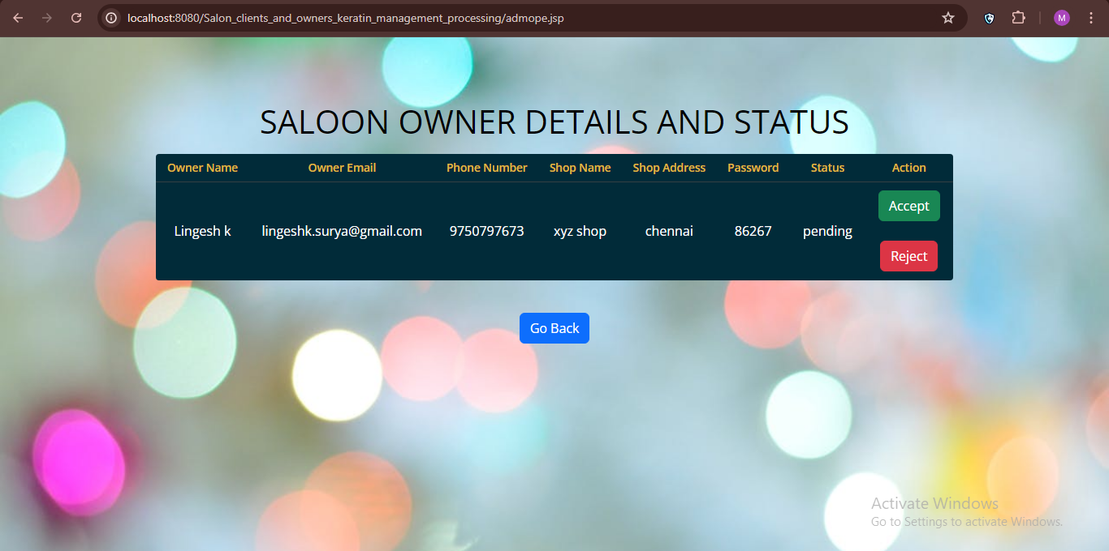
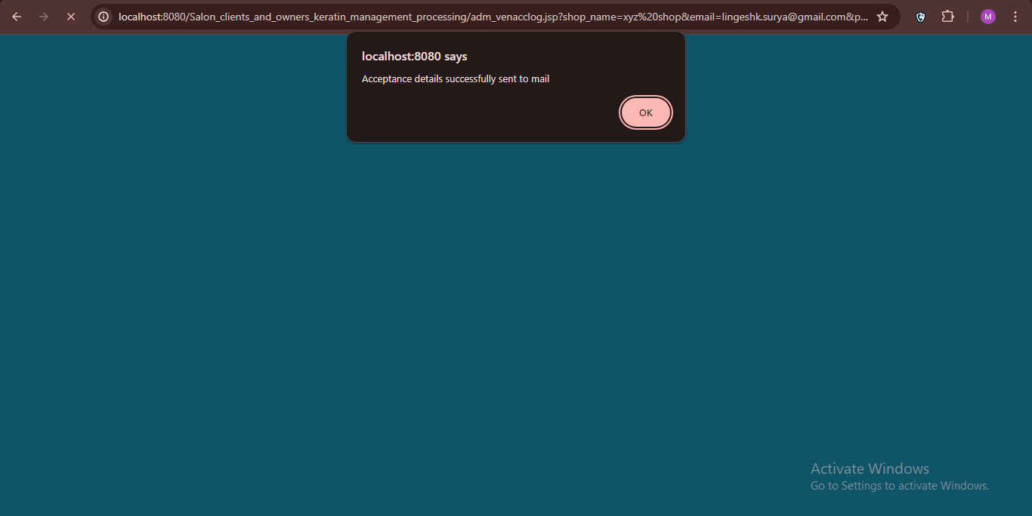
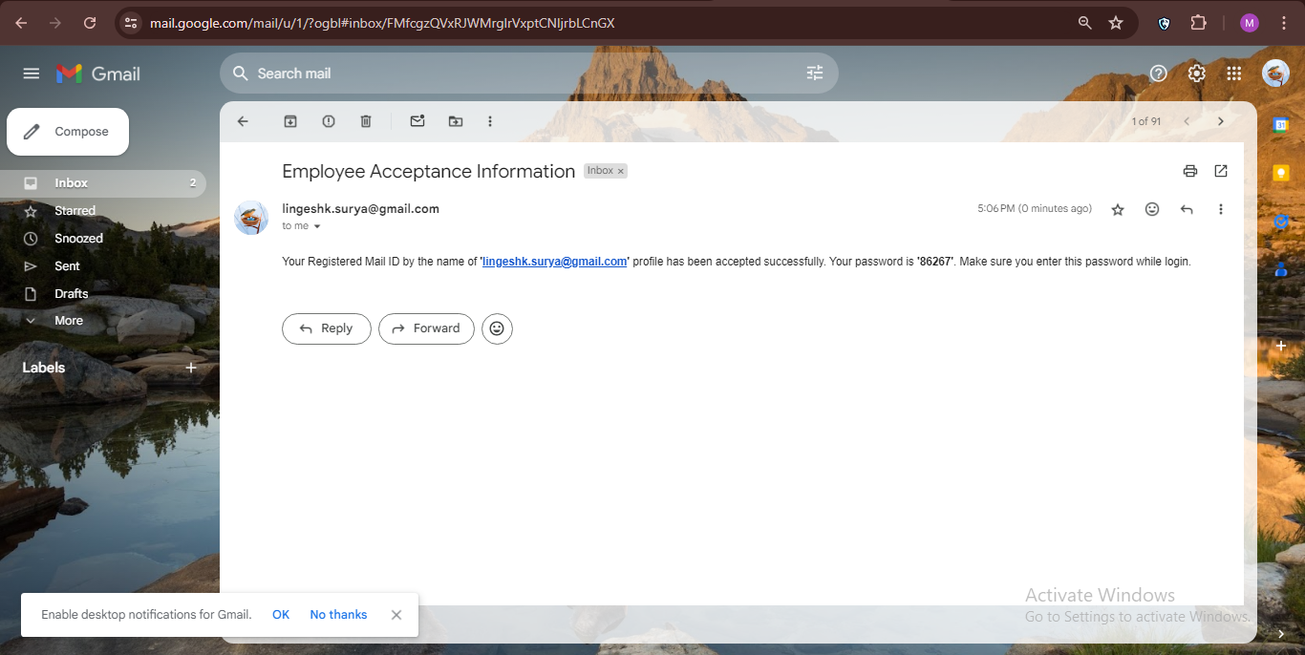
MODULE 2: OUTPUT

Slide 19
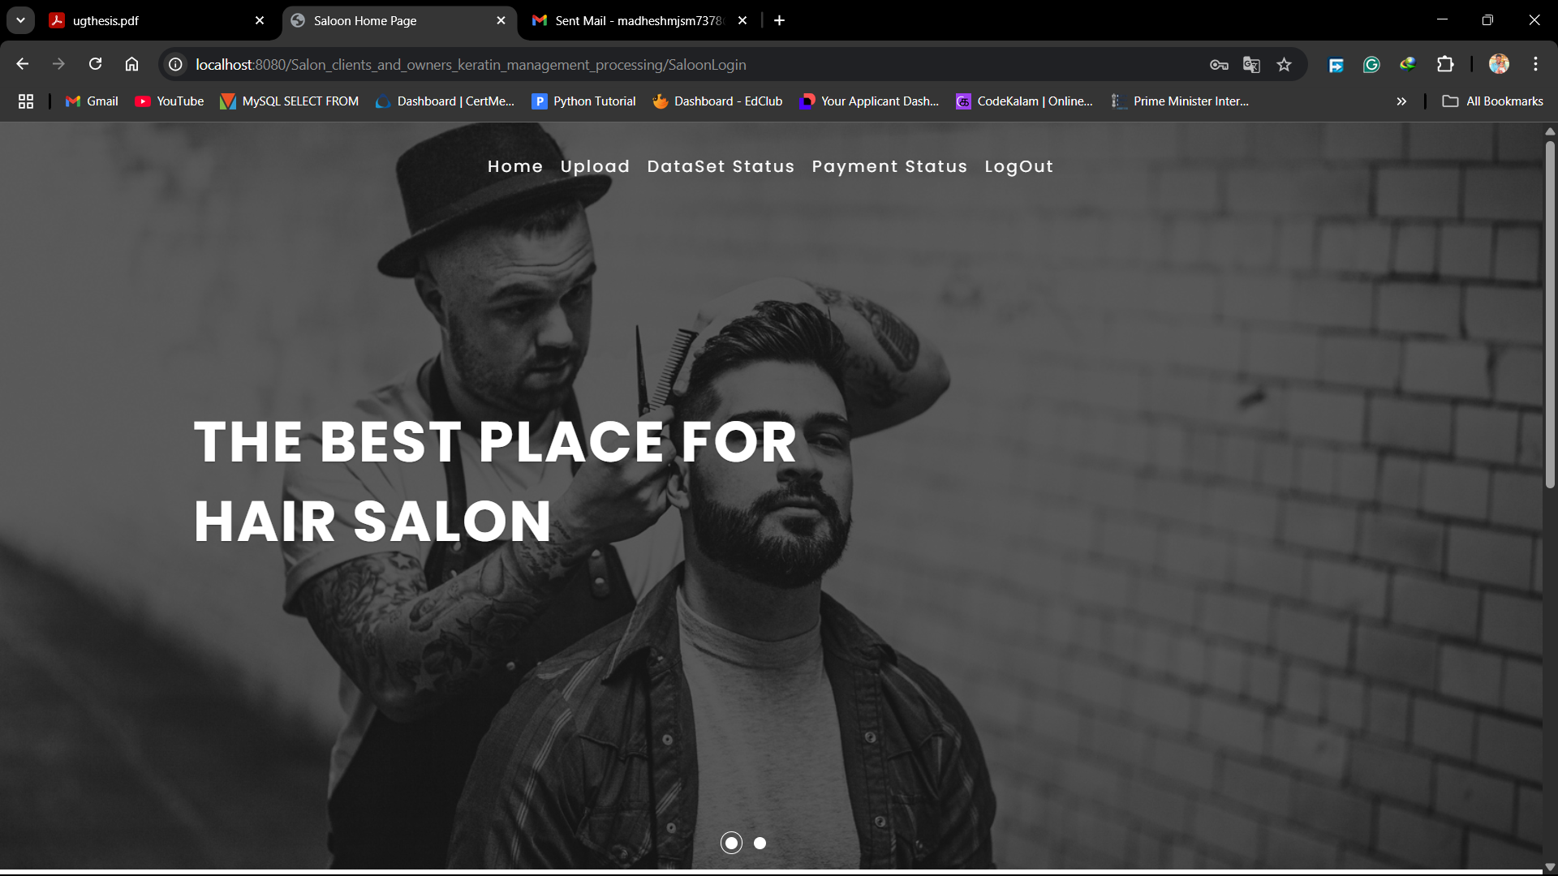
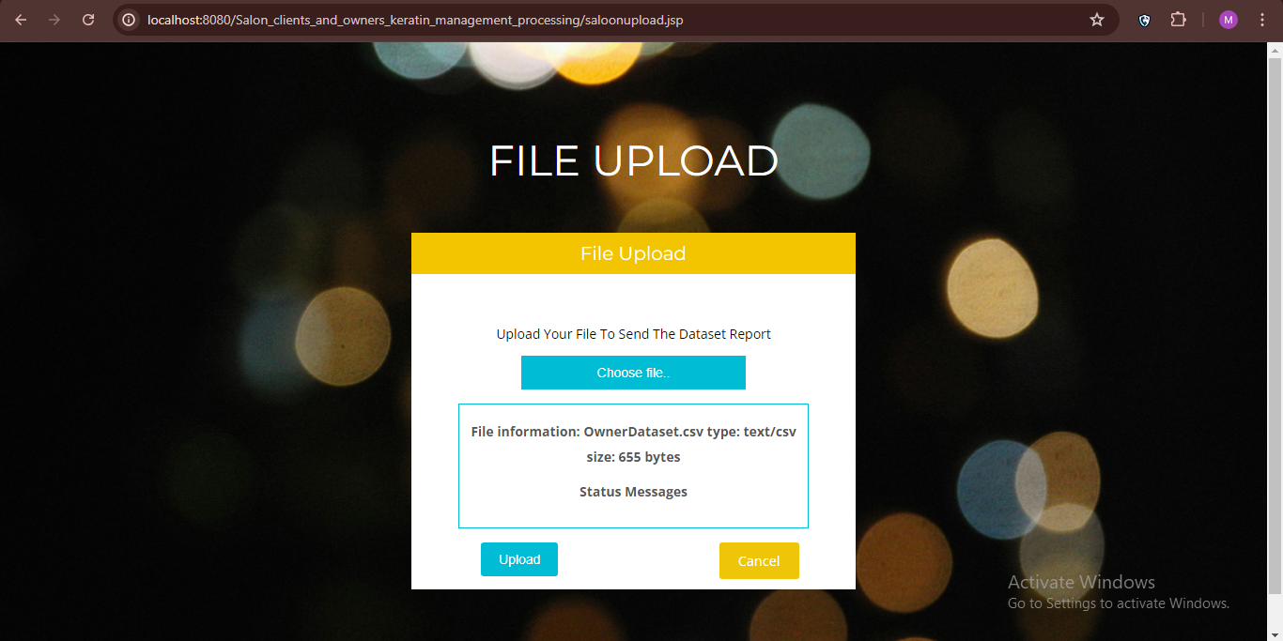
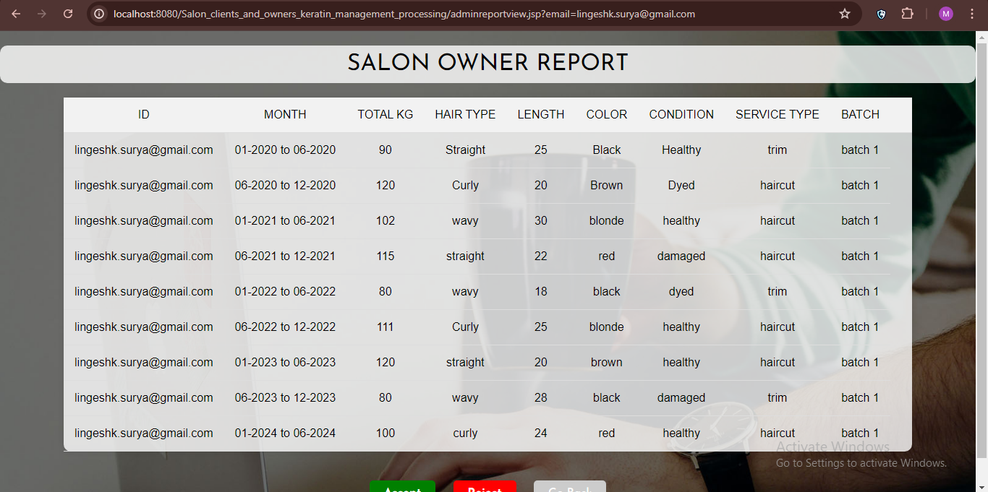
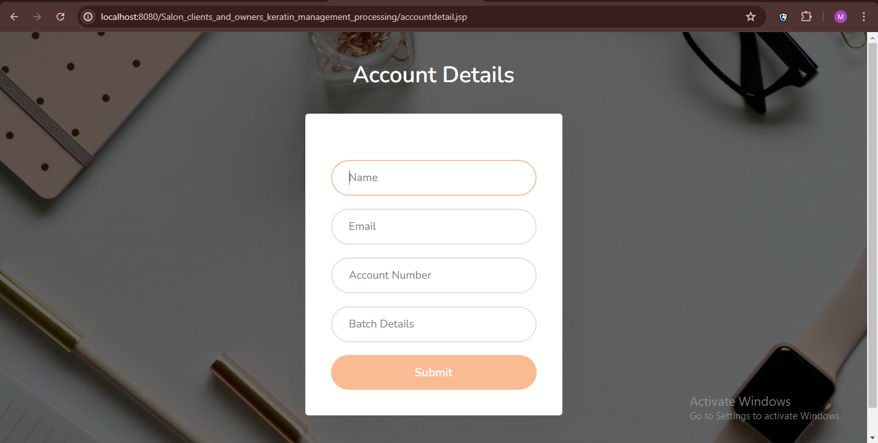
MODULE 2: OUTPUT(CONTD)

Slide 20
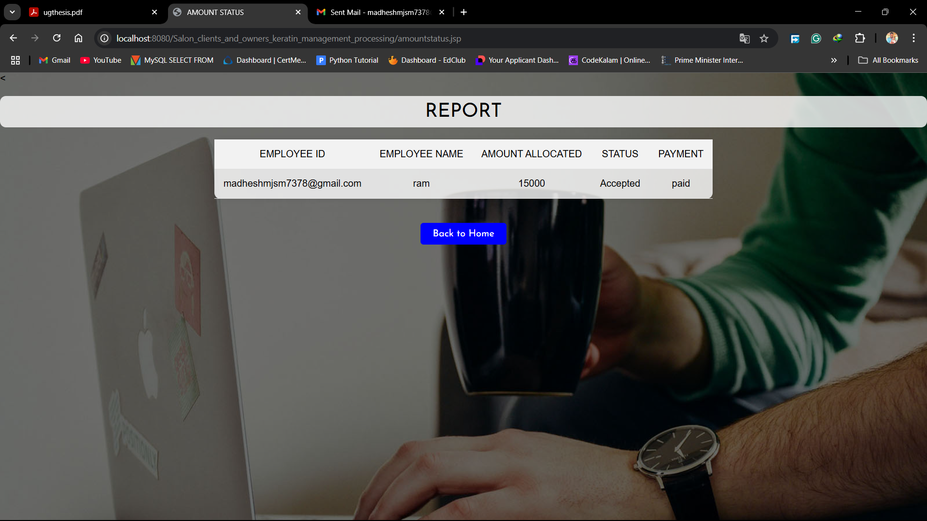
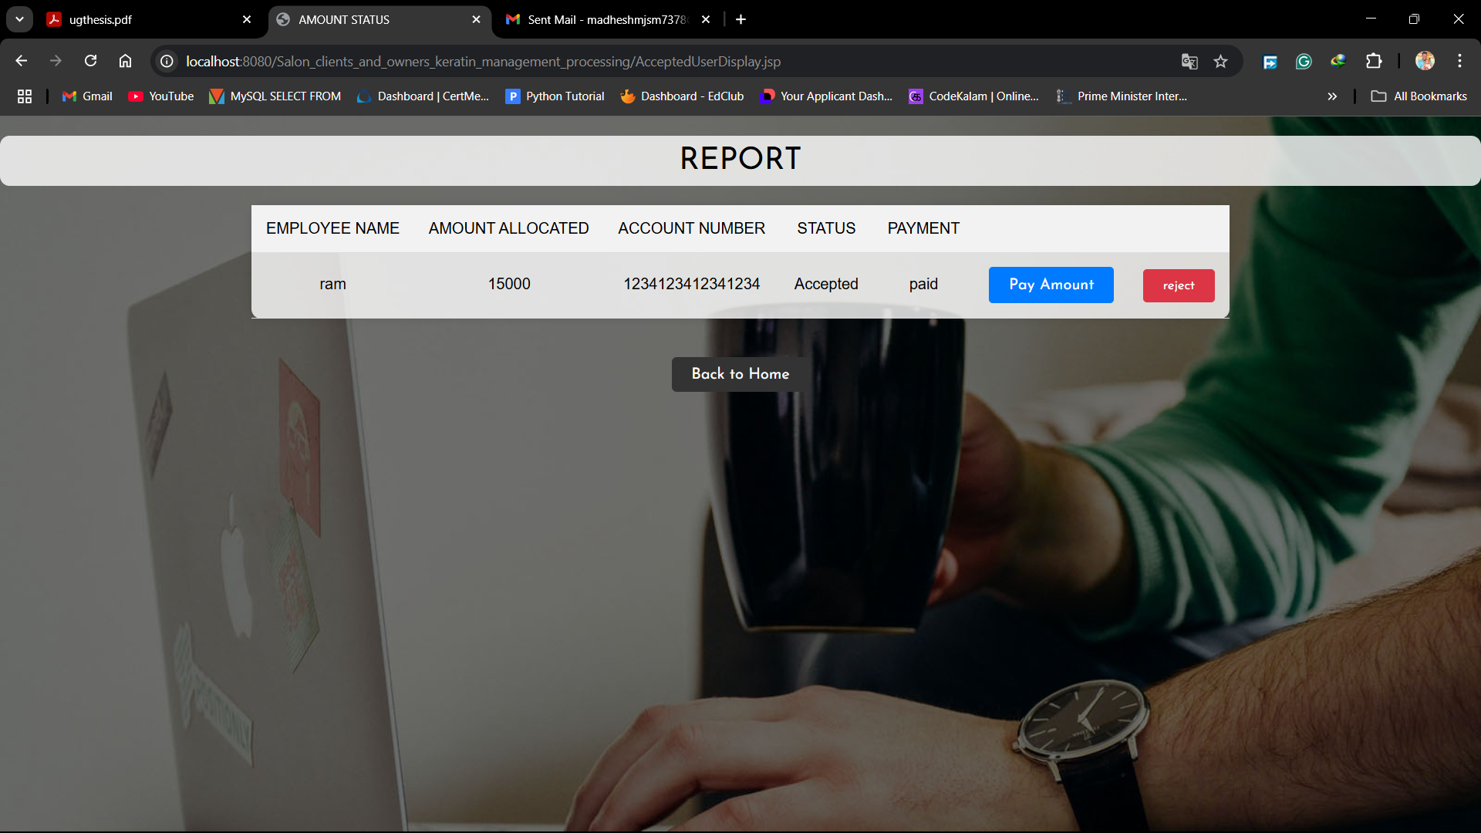
MODULE 2: OUTPUT(CONTD)

Slide 21
MODULE 3: COLLECTION MANAGEMENT
Employee Registration – Employees sign up with their personal and work details and wait for admin approval.
Secure Login – After approval, employees receive a password to log in securely.
Access to Approved Data – Employees can review salon data that has been approved by the admin.
Data Analysis & Reporting – Employees analyze melanin and keratin levels in collected hair and generate reports.
Report Submission & Logout – After submitting reports for admin review, employees securely log out.

Slide 22
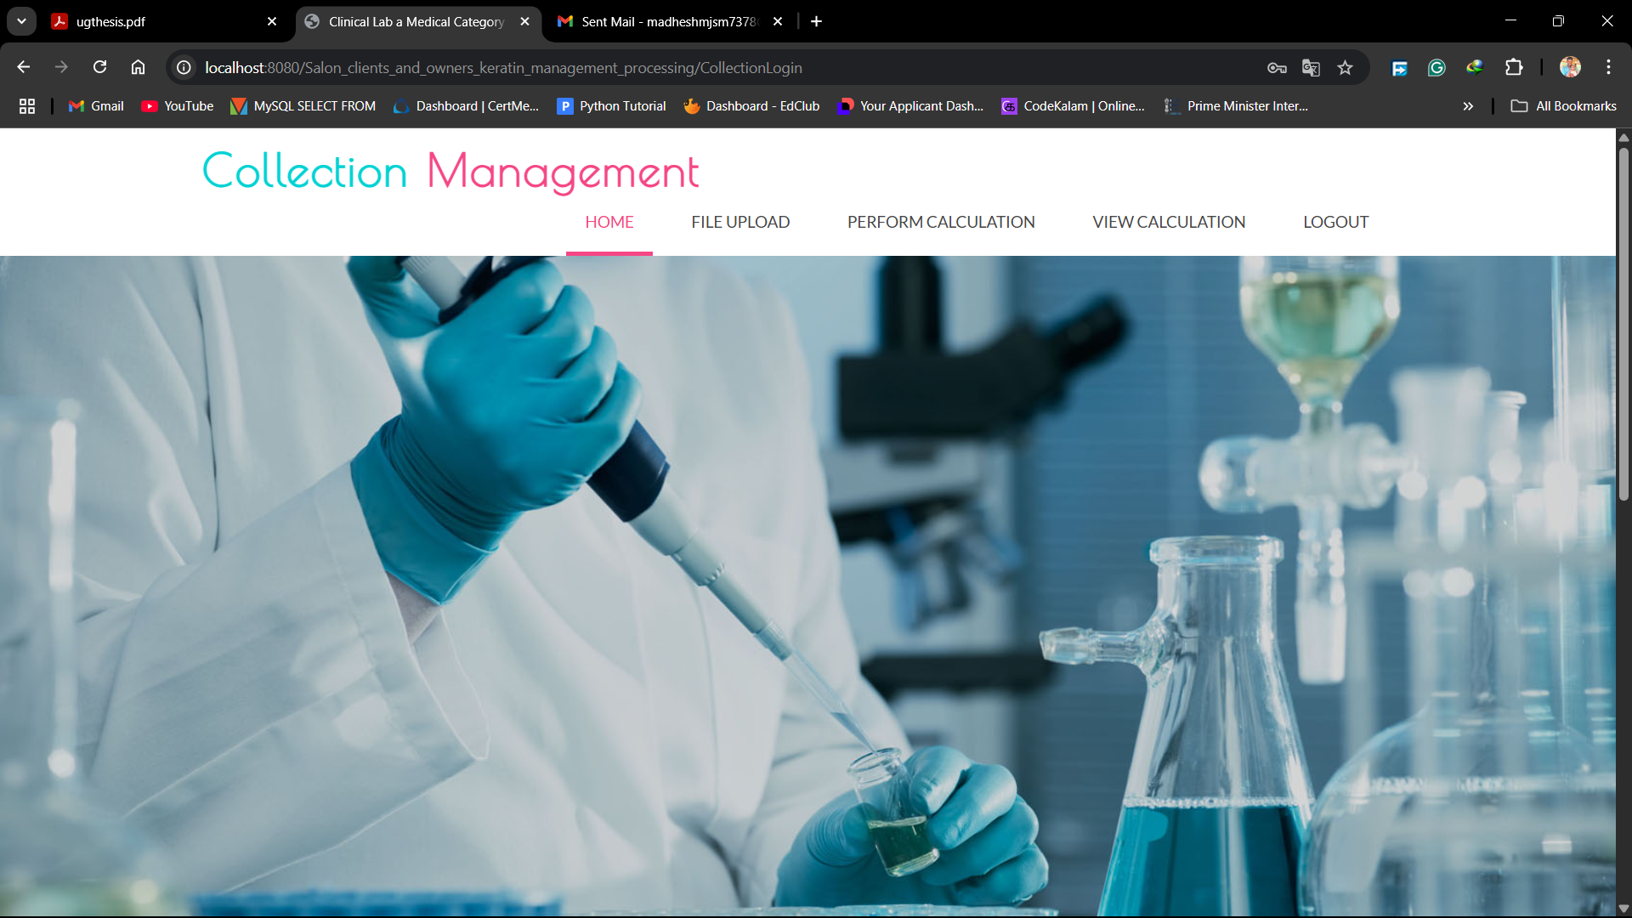
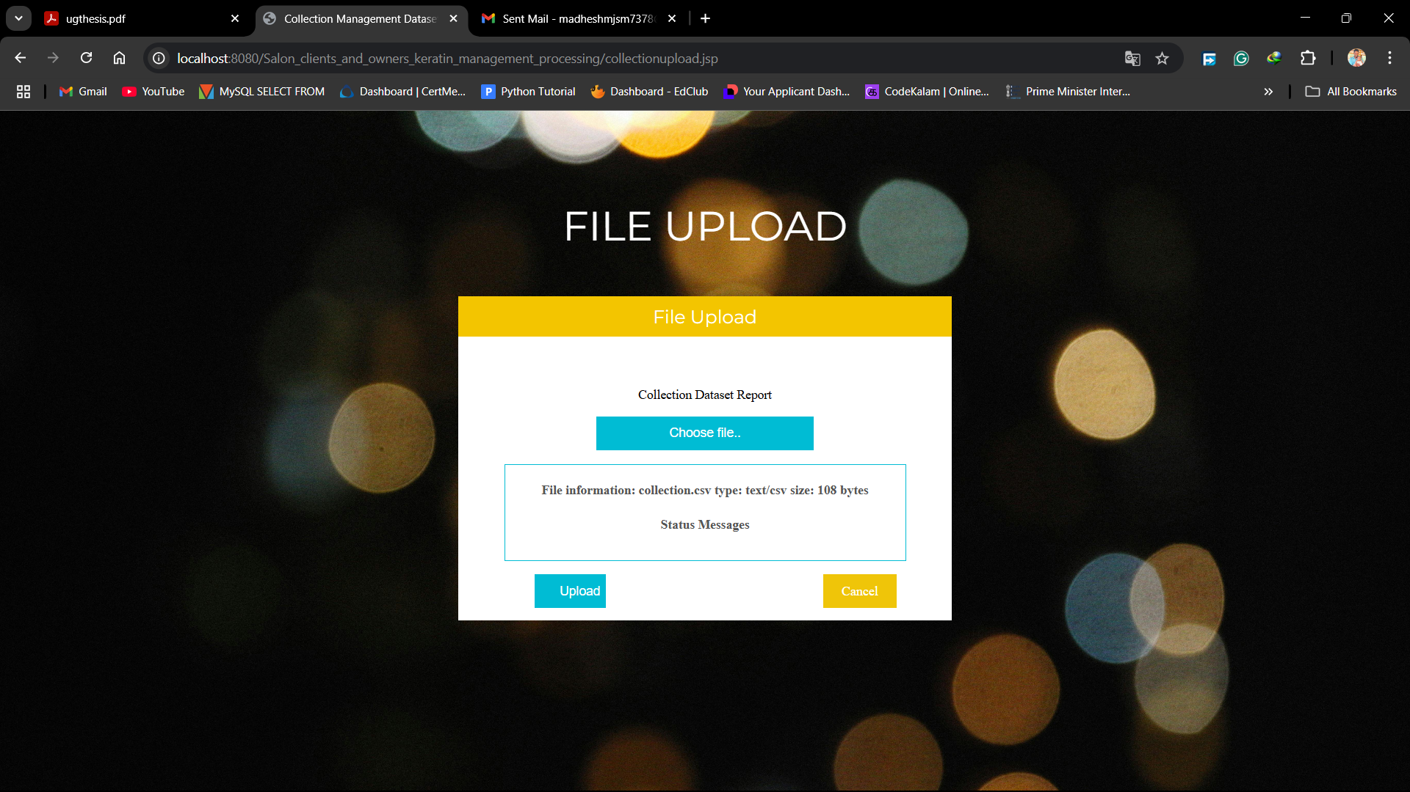
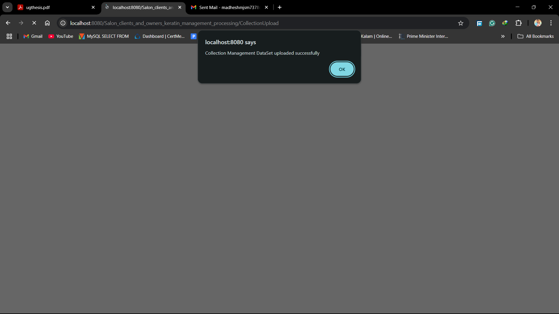
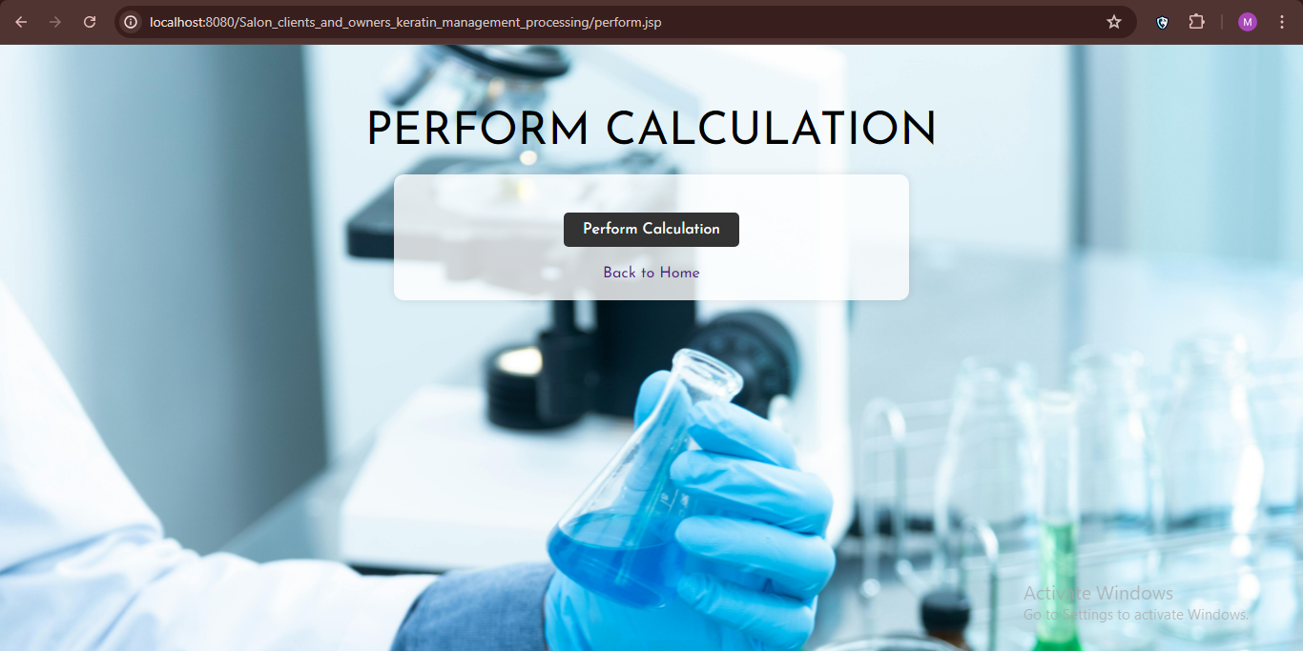
MODULE 3: OUTPUT

Slide 23
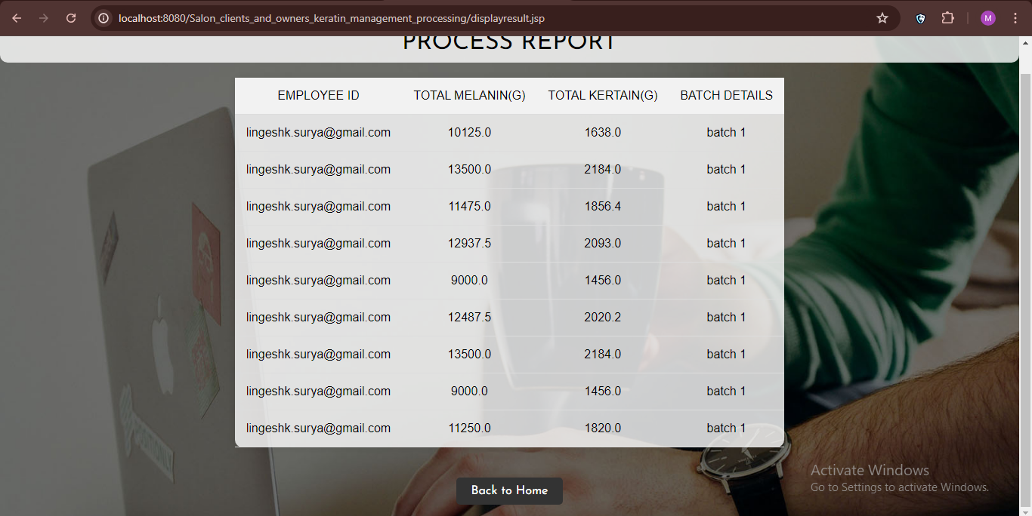

MODULE 3: OUTPUT(contd)

Slide 24
MODULE 4: PROCESS ANALYSIS
Employee Registration & Approval – The employee registers and waits for admin approval before accessing the system.
Secure Login – Employees use admin-approved credentials to access the module securely.
Data Review & Upload – The employee reviews approved collection management data and uploads melanin and keratin information.
Experimental Testing – Conducts temperature-based experiments using ionic liquids to analyze melanin and keratin properties.
Report Submission – After analyzing results, a detailed report is submitted to the admin for review and further processing.

Slide 25
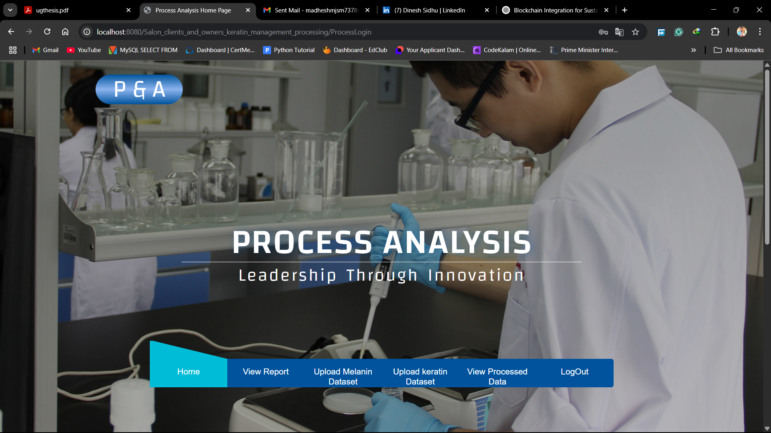
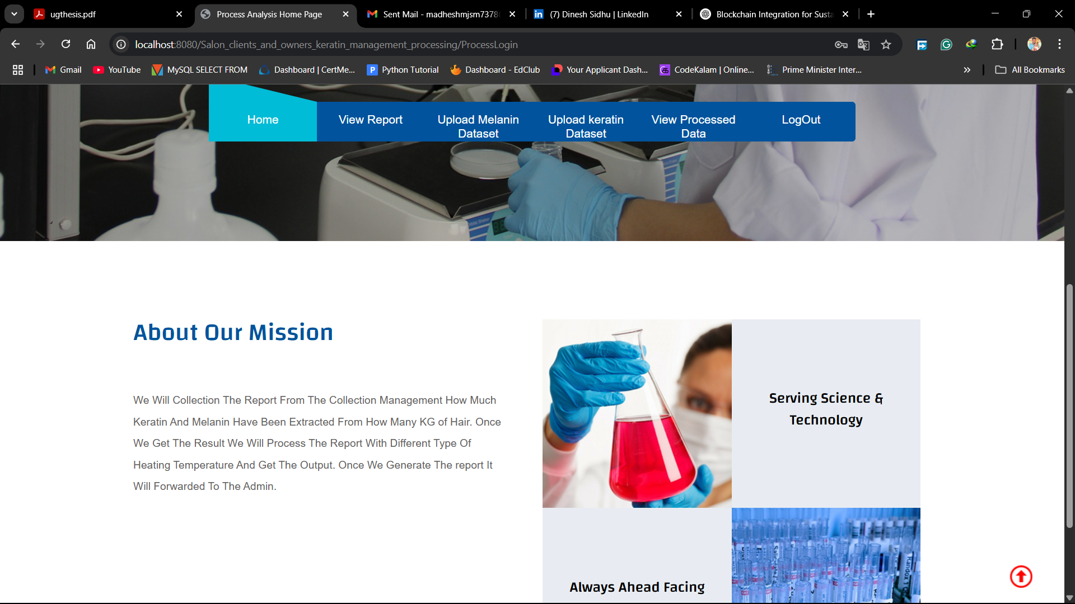
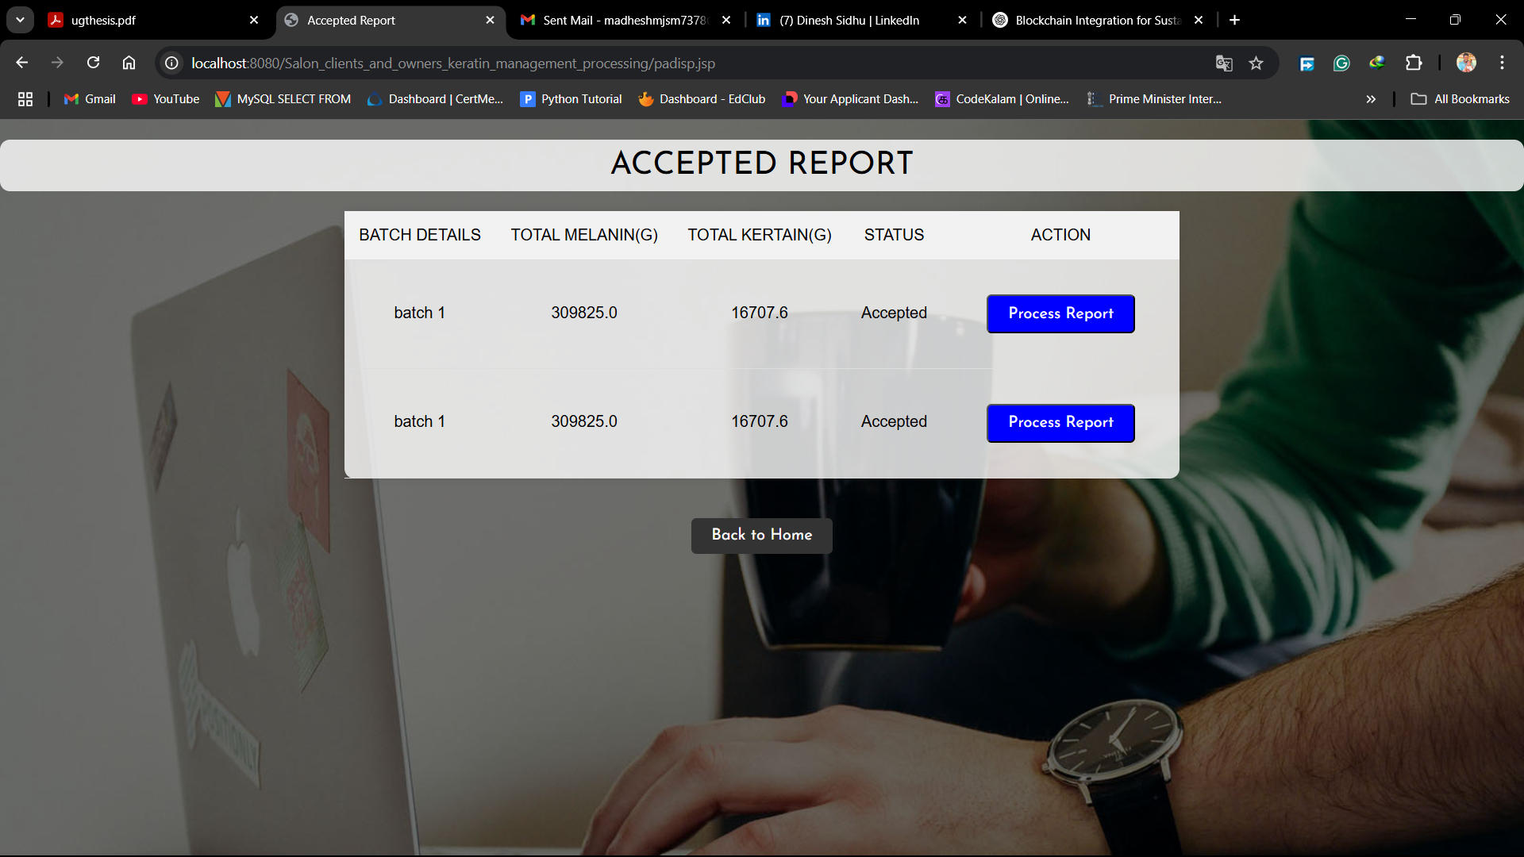
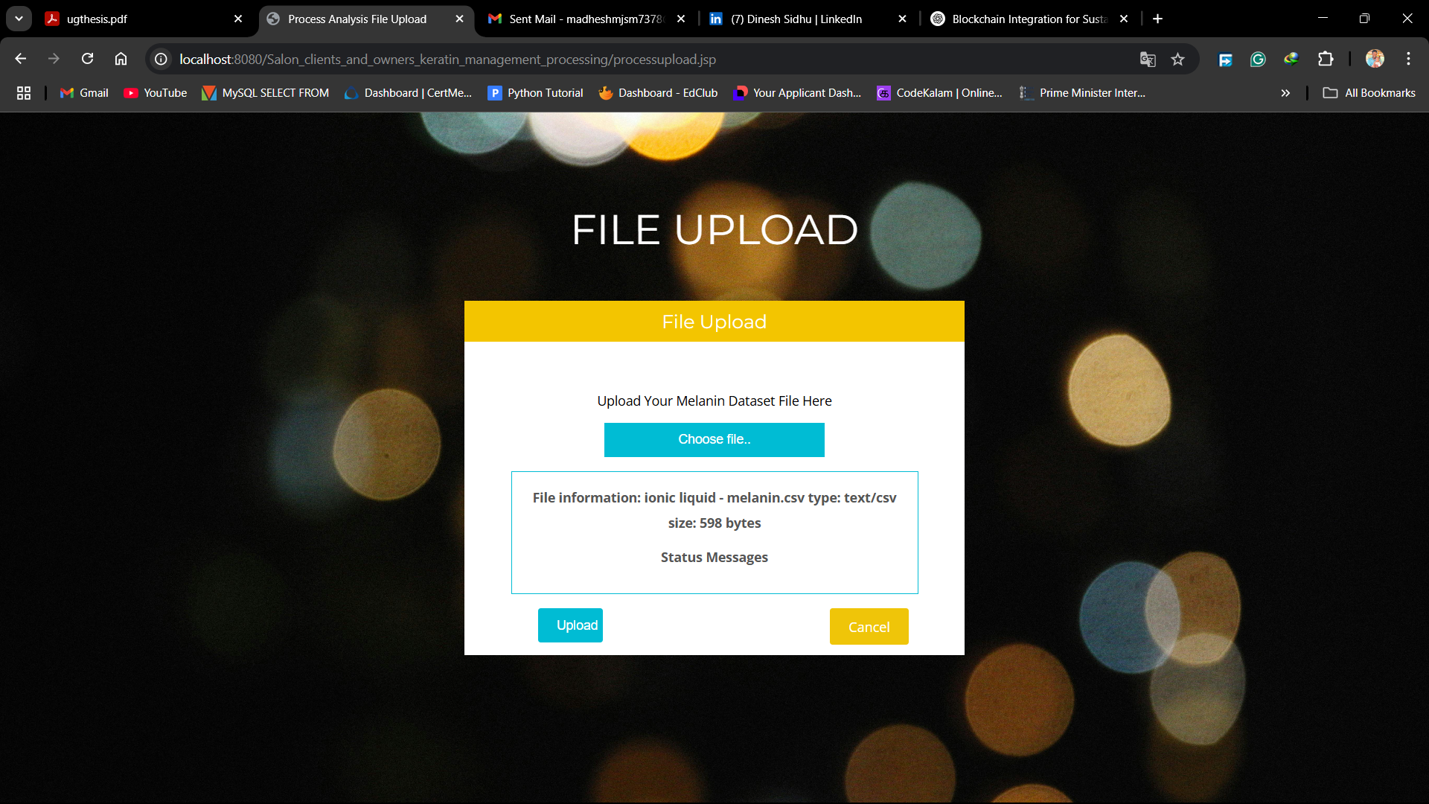
MODULE 4: OUTPUT

Slide 26

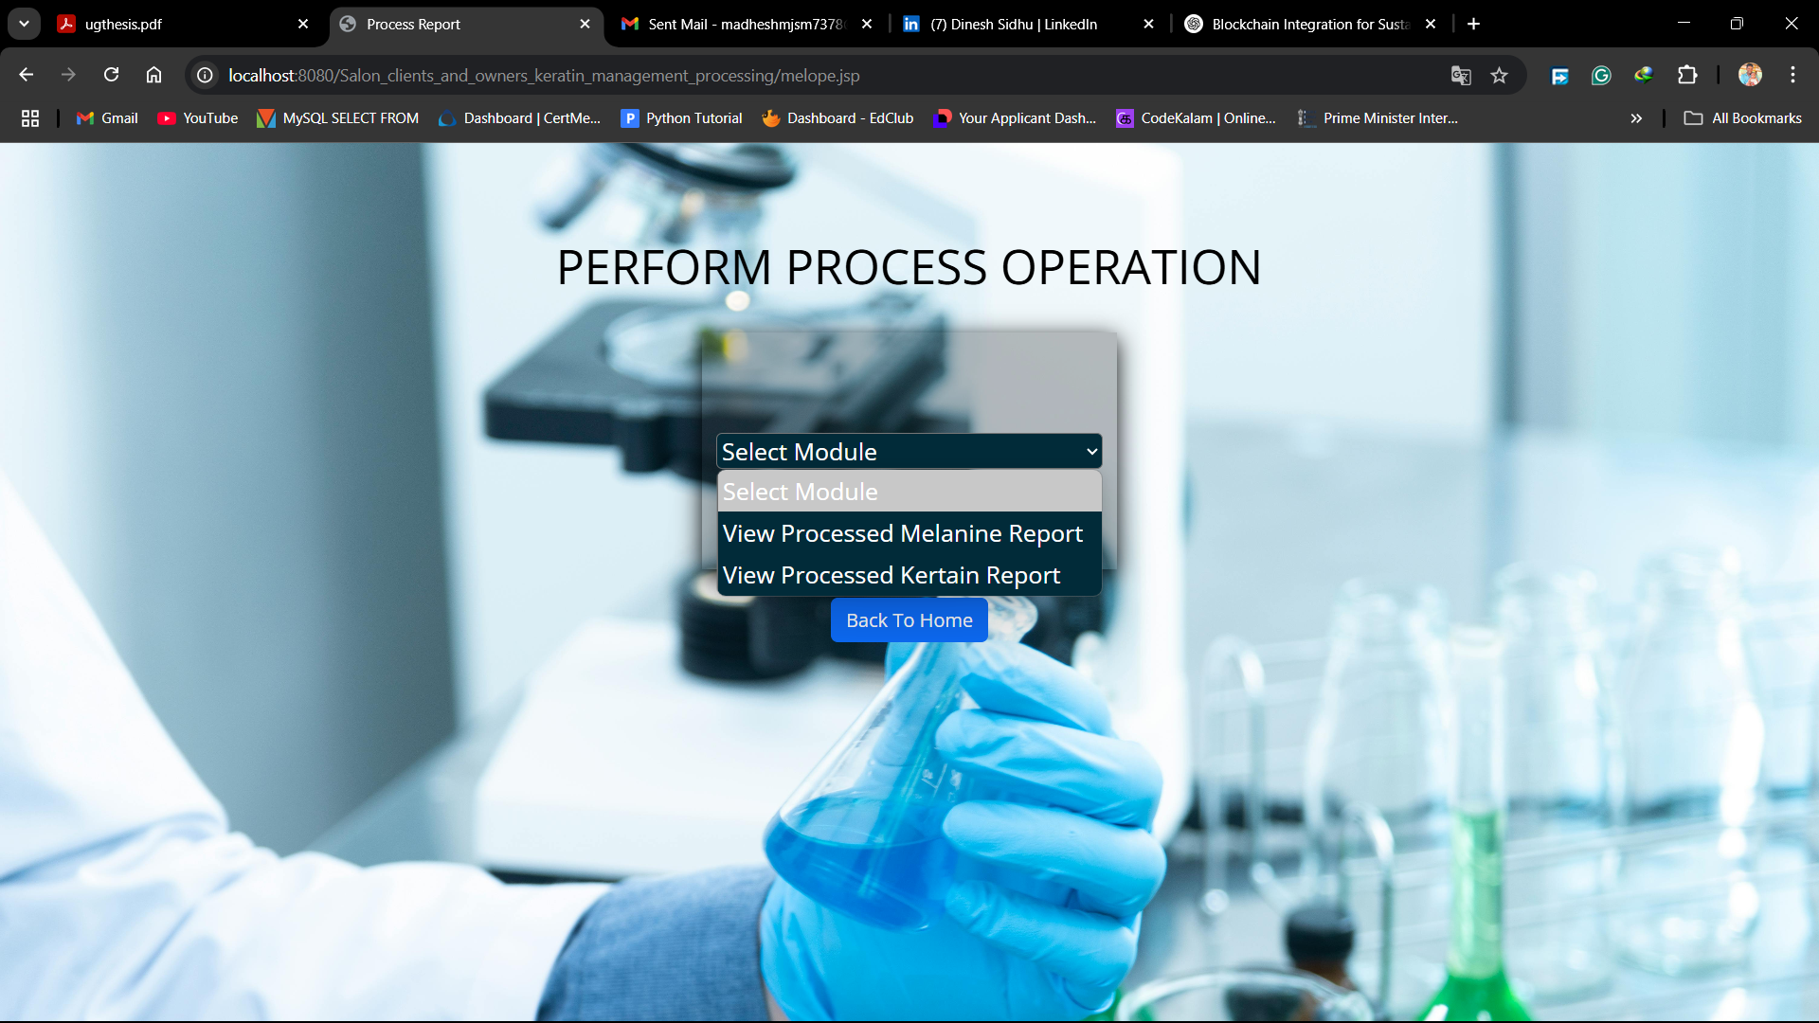
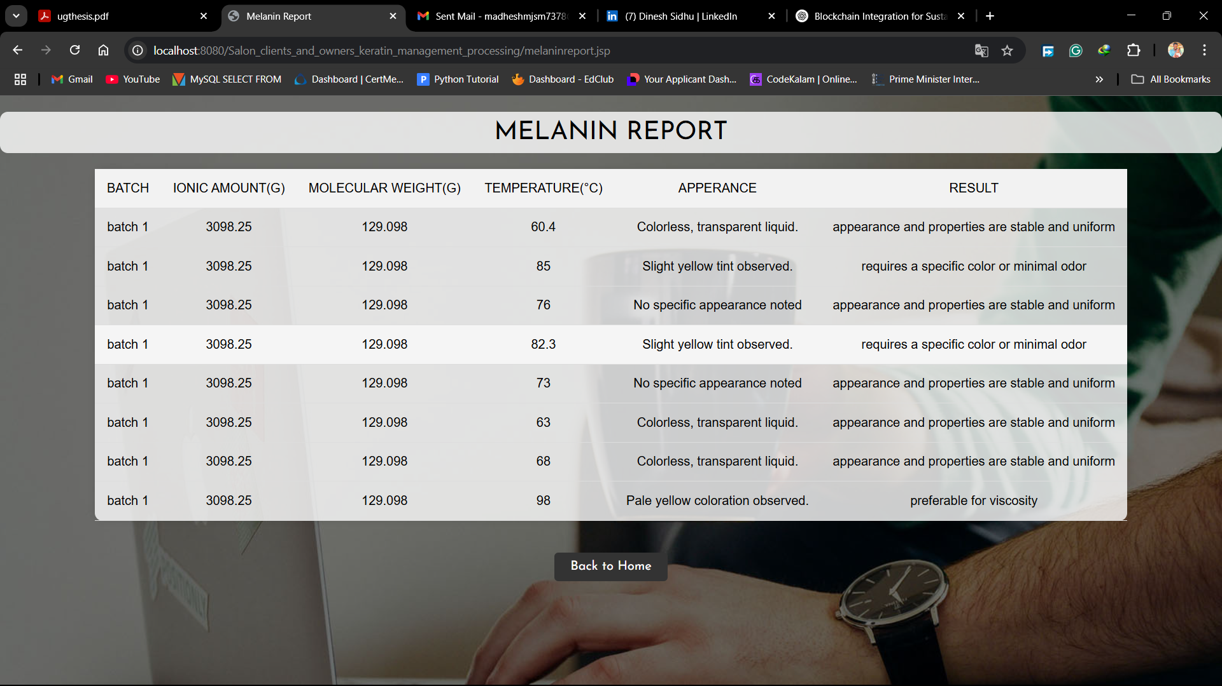
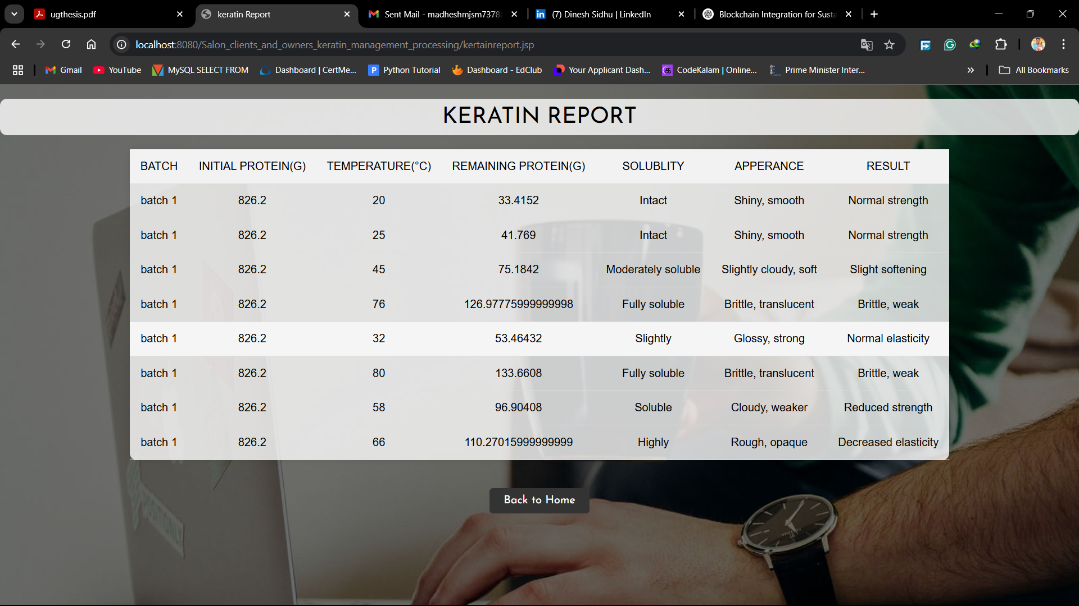
MODULE 4: OUTPUT(CONTD)

Slide 27
MODULE 5: ADMIN
User Management – The admin reviews and approves user registrations for salon owners, collection management employees, and process analysis employees.
Product Uploads – The admin uploads product details, which are visible to clients for purchases.
Report Review & Approval – The admin examines reports from salon owners, collection management, and process analysis employees before approving or rejecting them.
Payment Processing – For approved salon reports, the admin allocates payments and processes transactions.
Comprehensive Report Download – The admin can generate and download a summary of all approved reports across different modules.

Slide 28
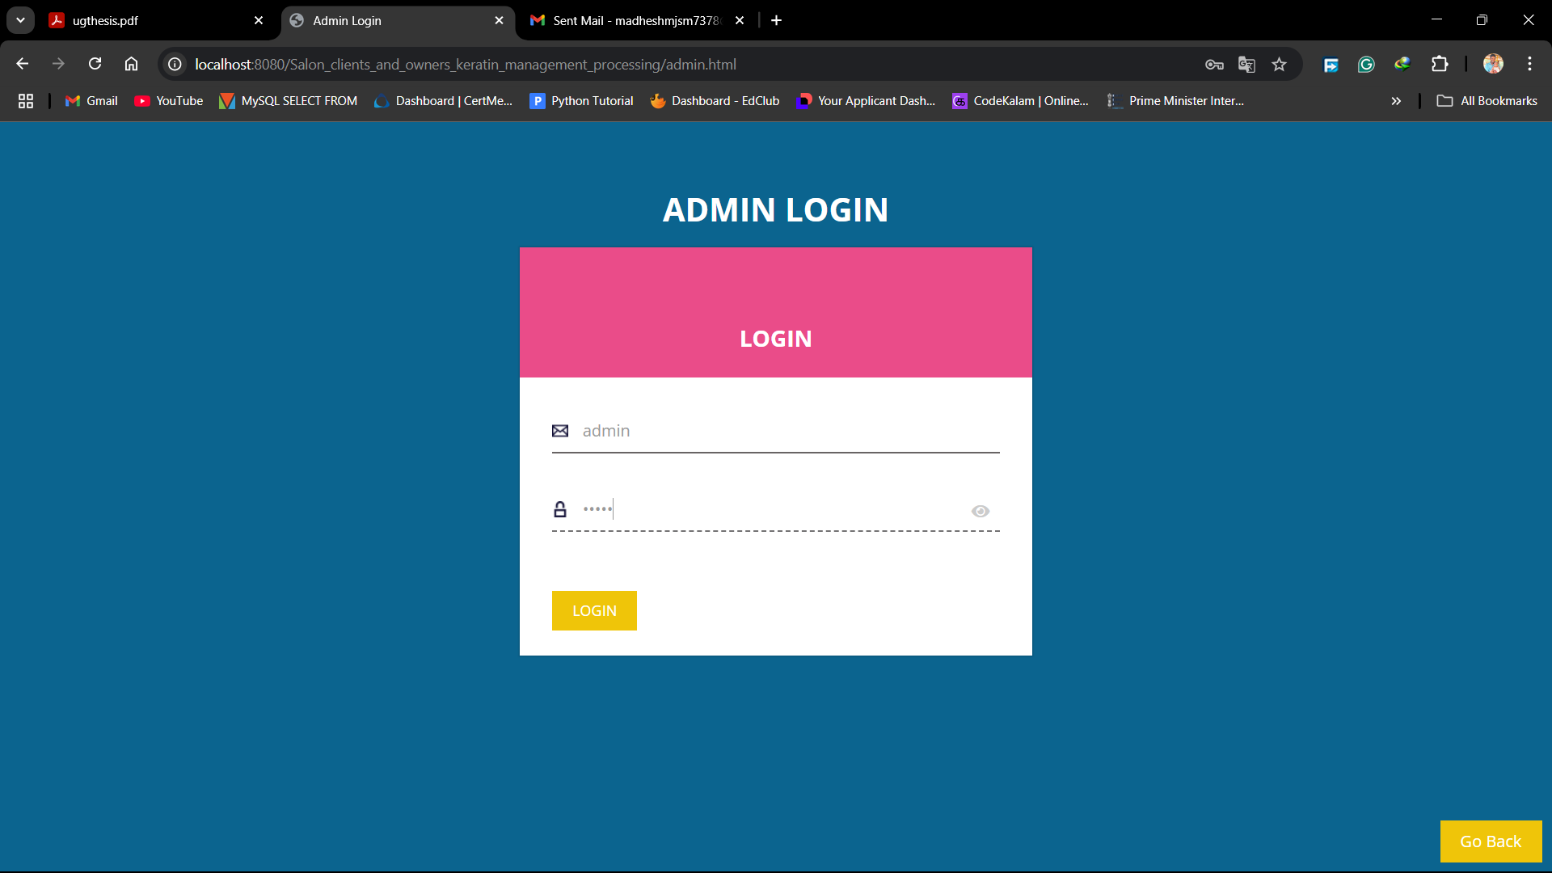
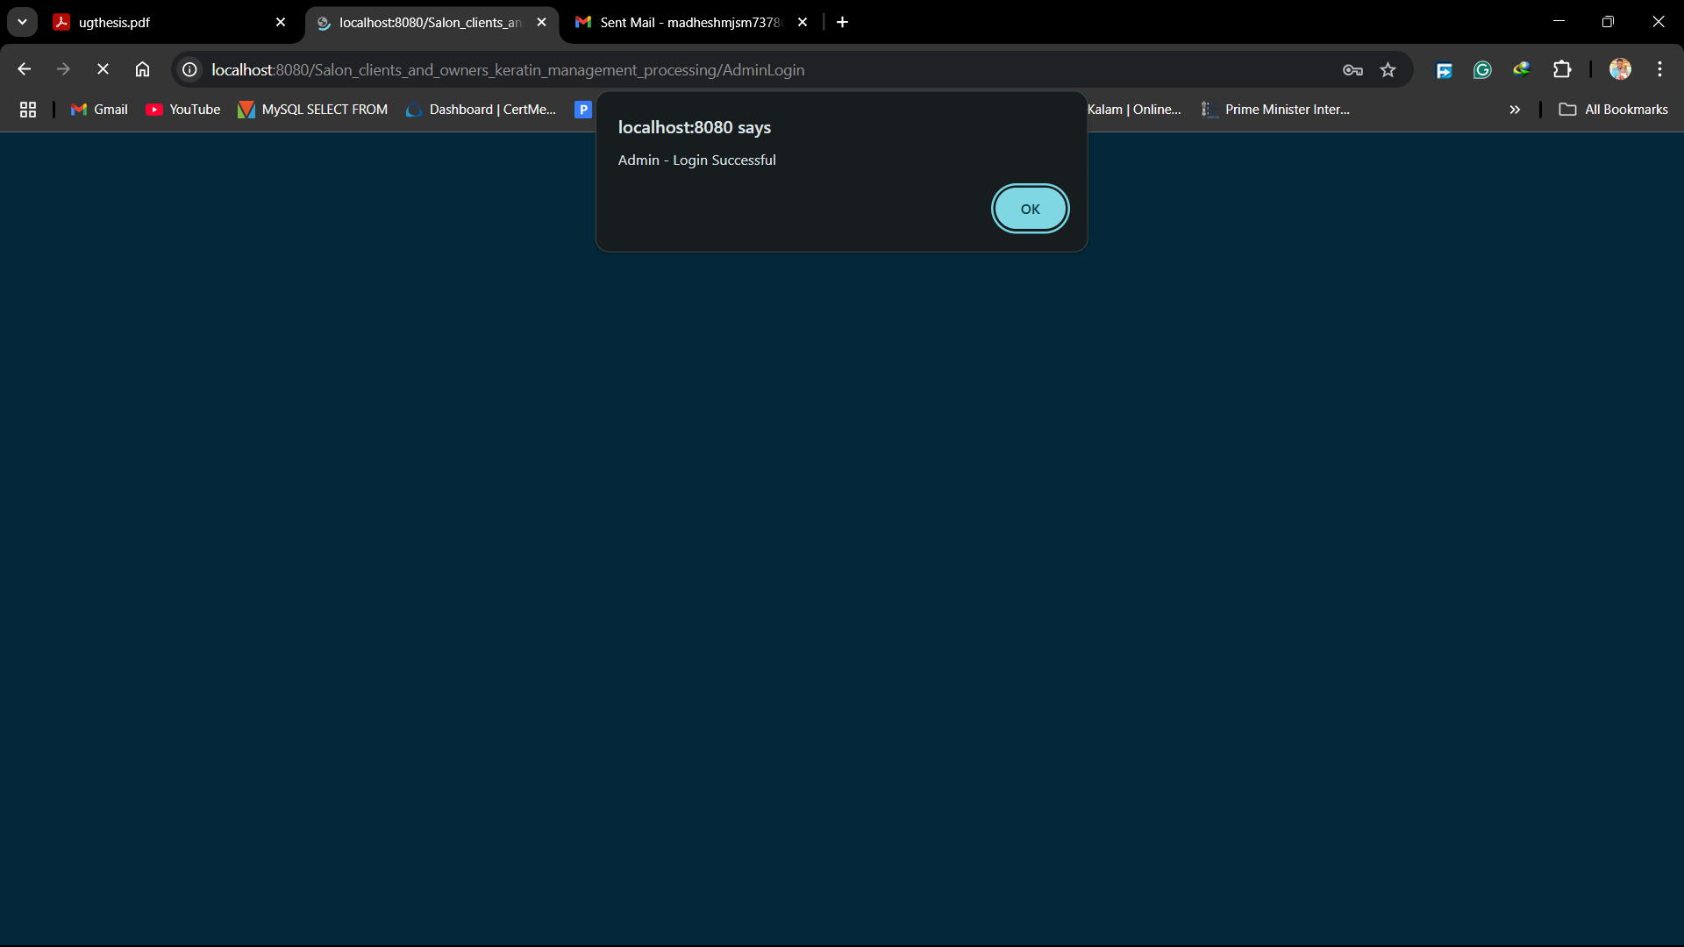
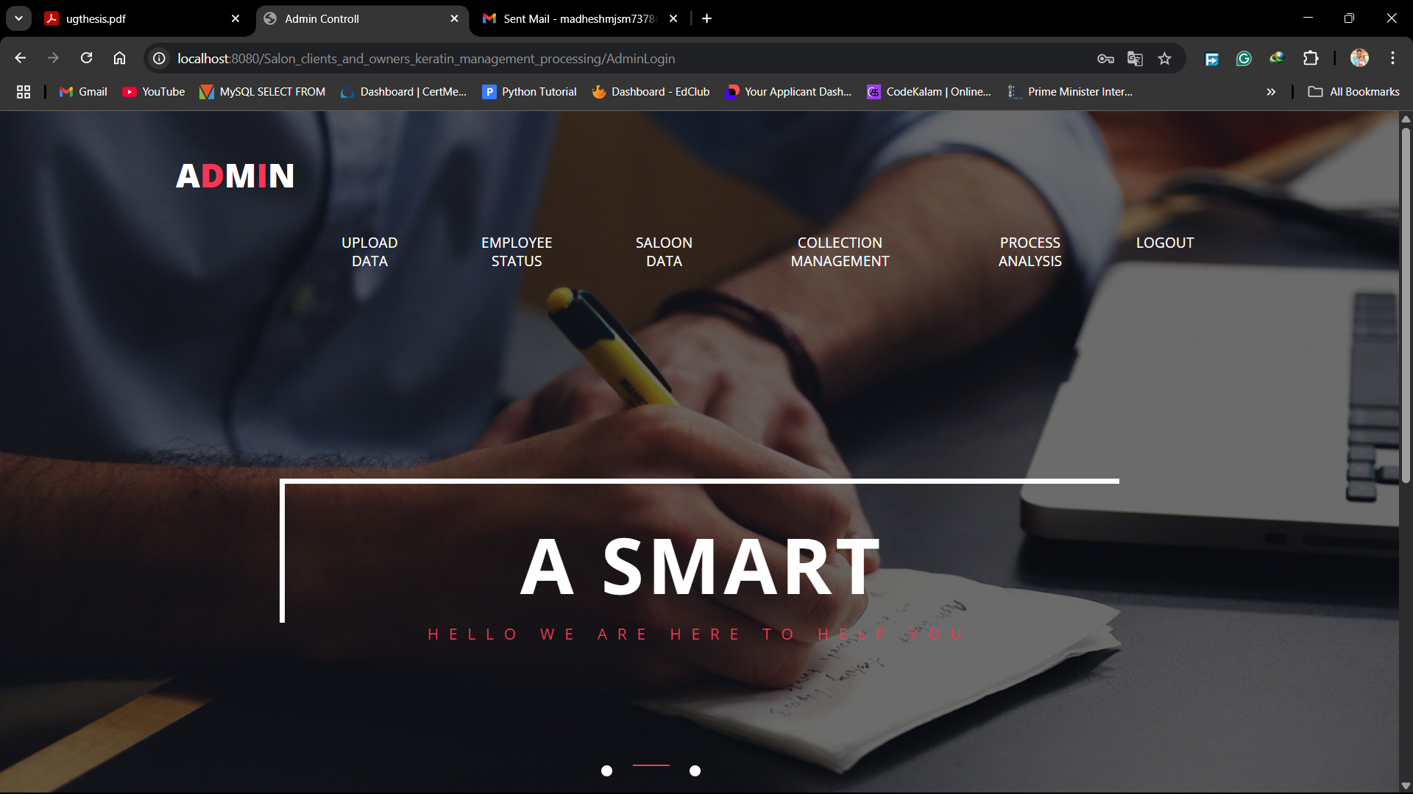
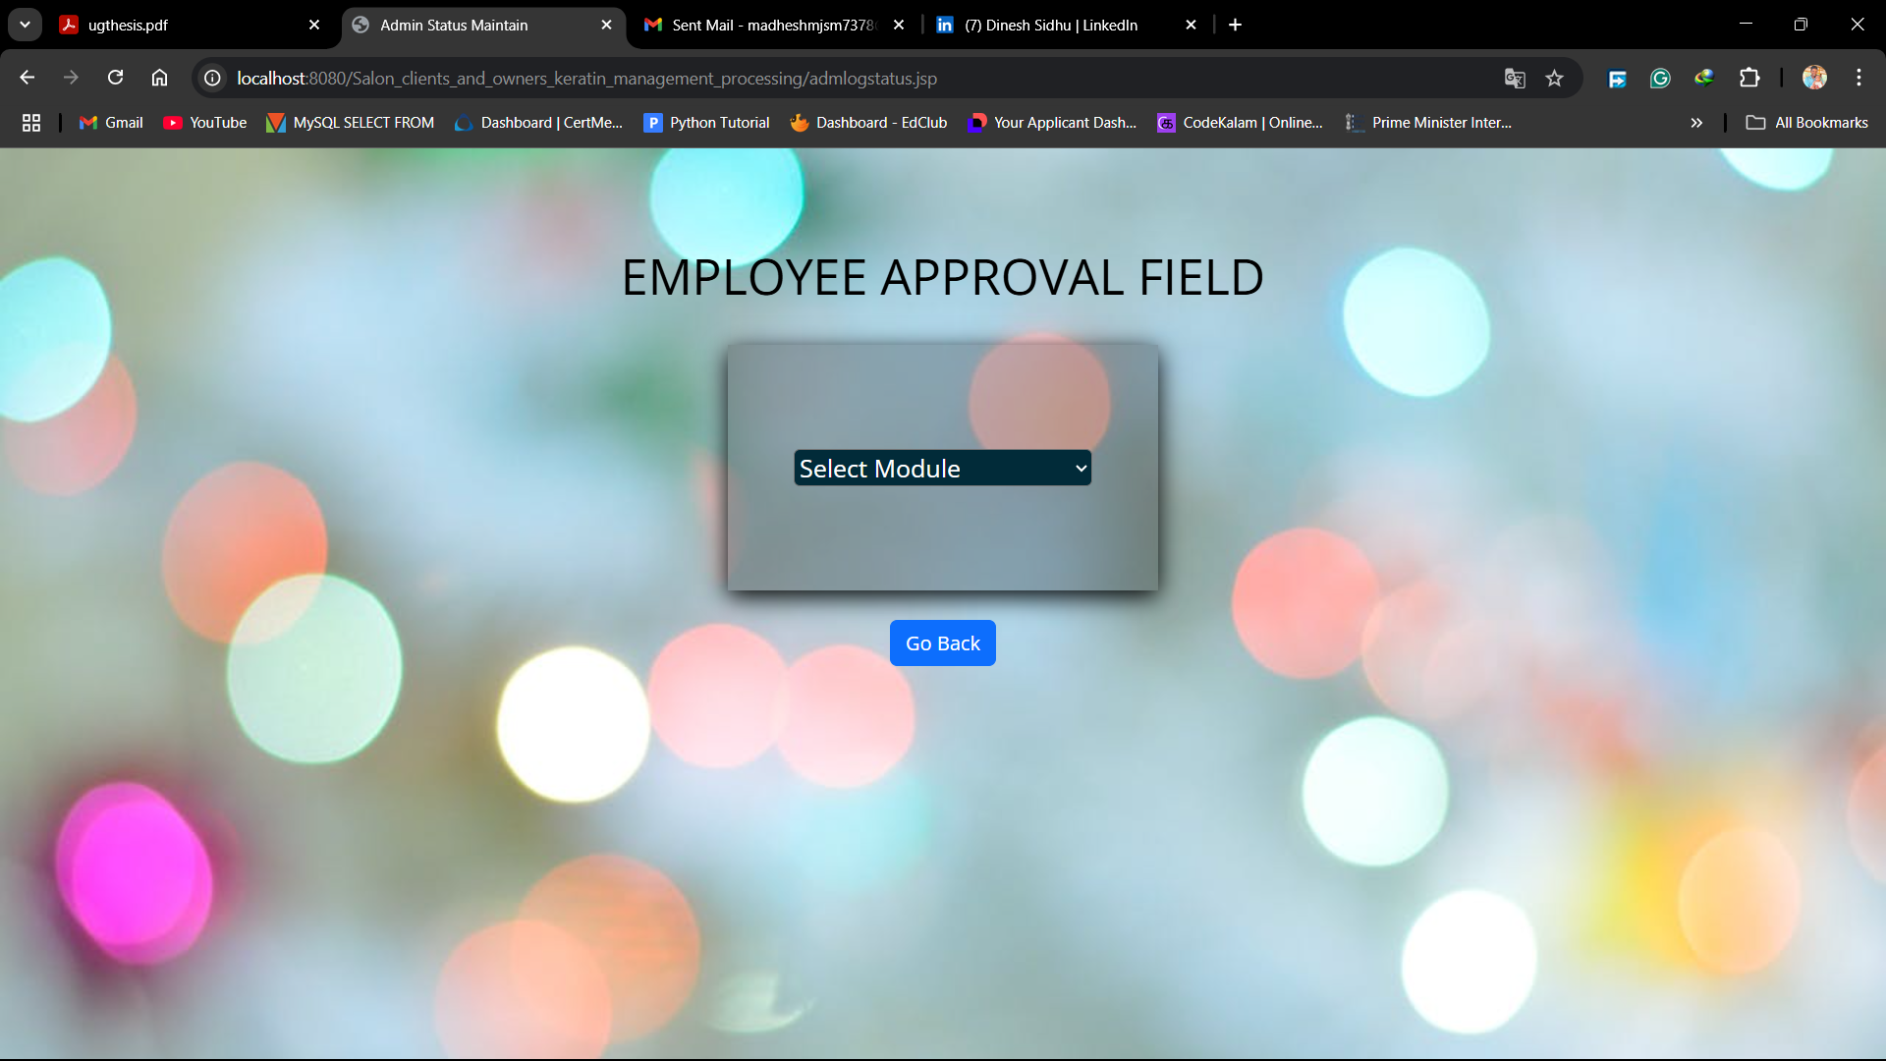
MODULE 5: OUTPUT

Slide 29
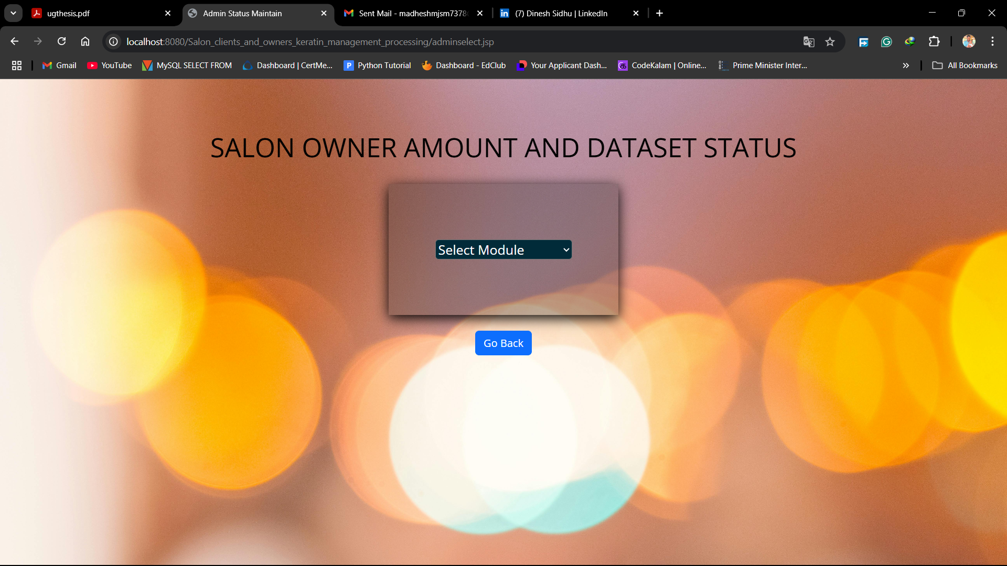
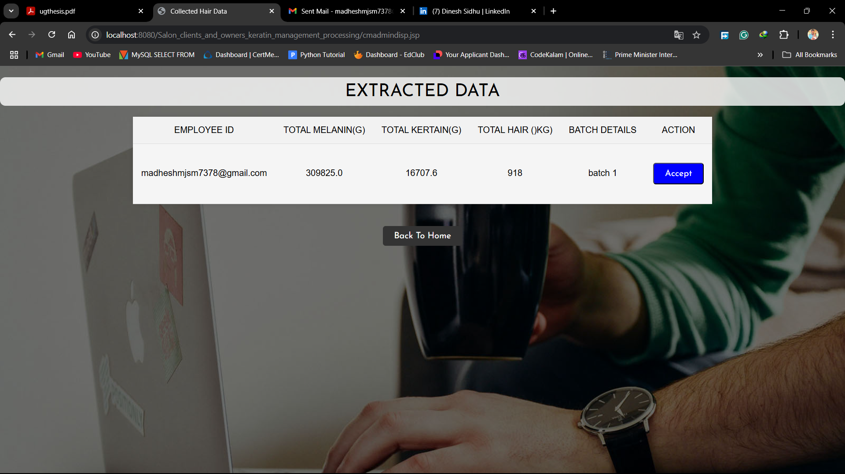
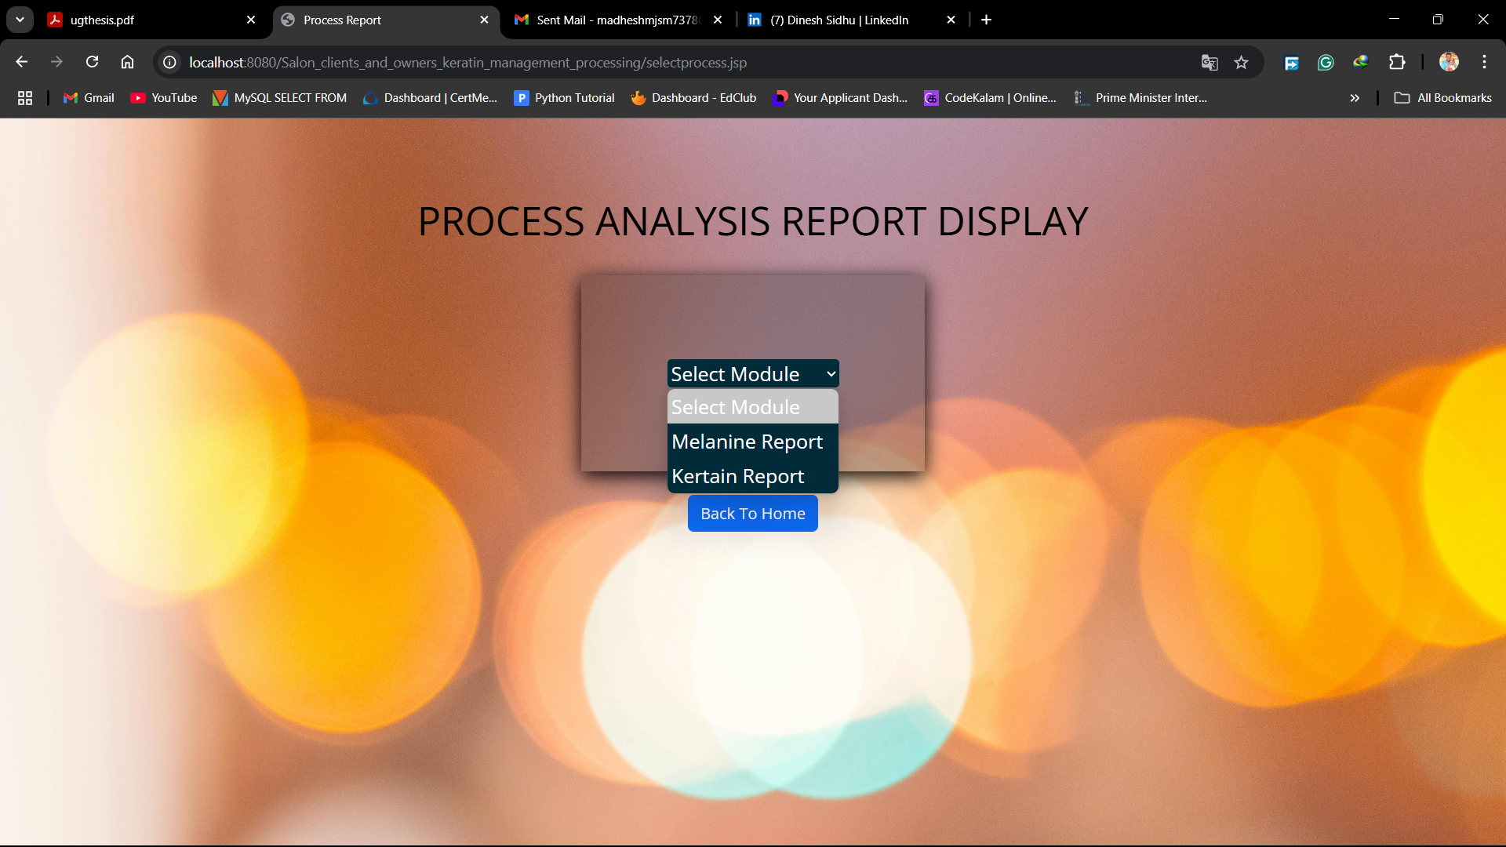
MODULE 5: OUTPUT(CONTD)

Slide 30
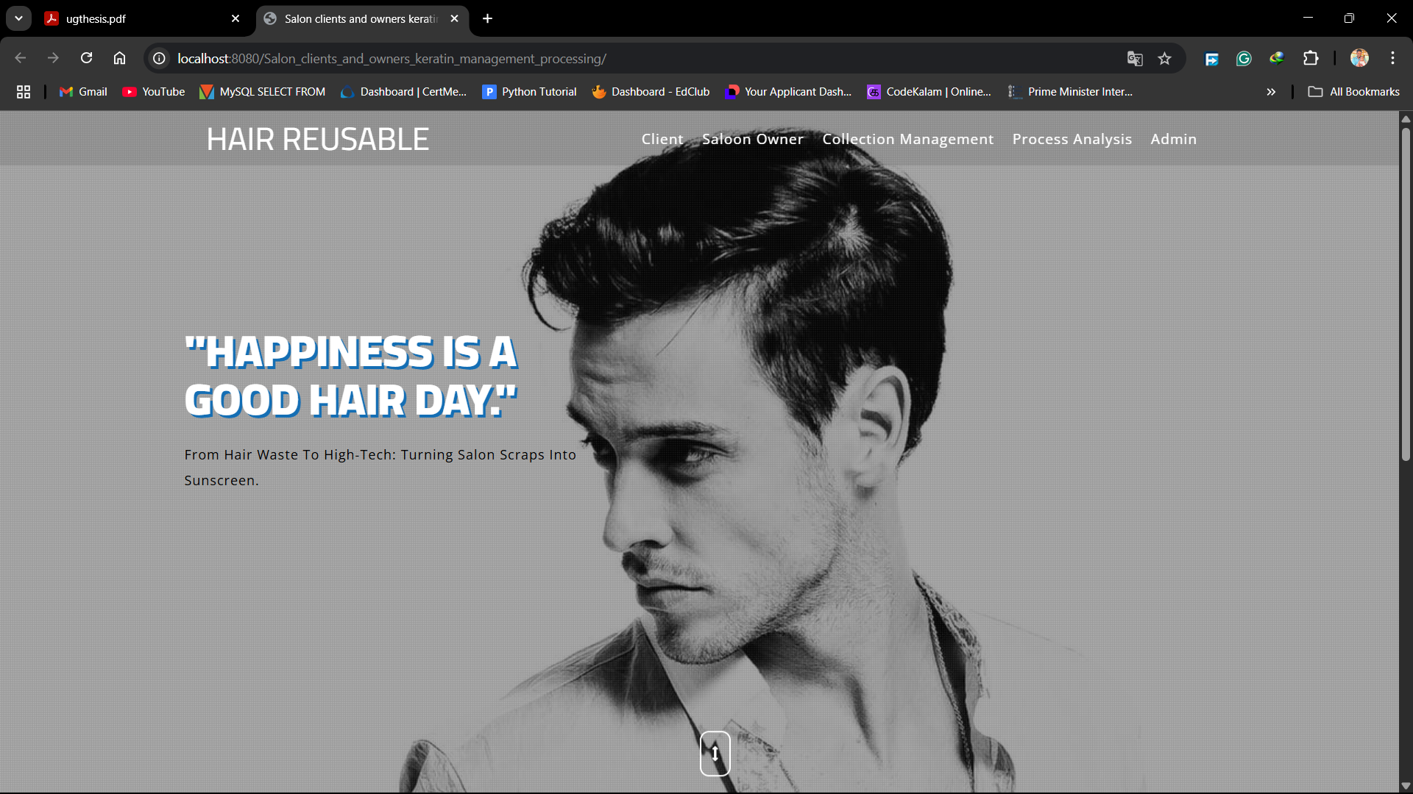
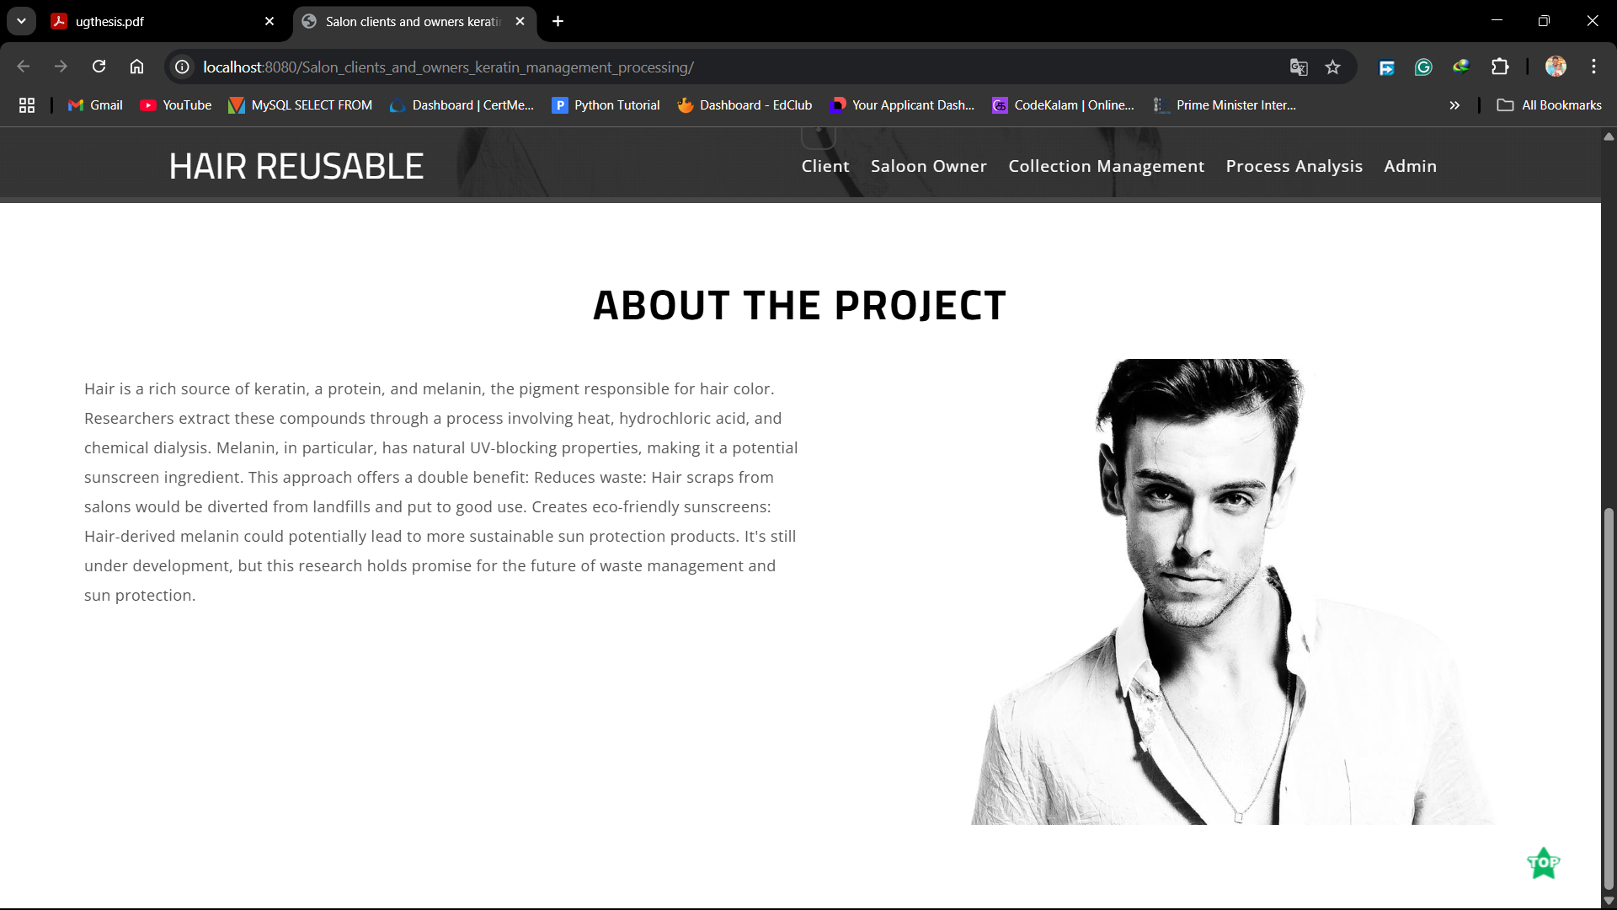
OVERALL OUTPUT

Slide 31
Future Enhancement
End-to-end traceability of hair waste from collection at salons to final product manufacturing.
Tamper-proof data records to ensure the authenticity of quality and ethical sourcing.
Smart contracts for automating transactions between salons and manufacturers, reducing delays and manual errors.
Consumer transparency, enabling customers to trace the origin of ingredients in beauty products.

Slide 32
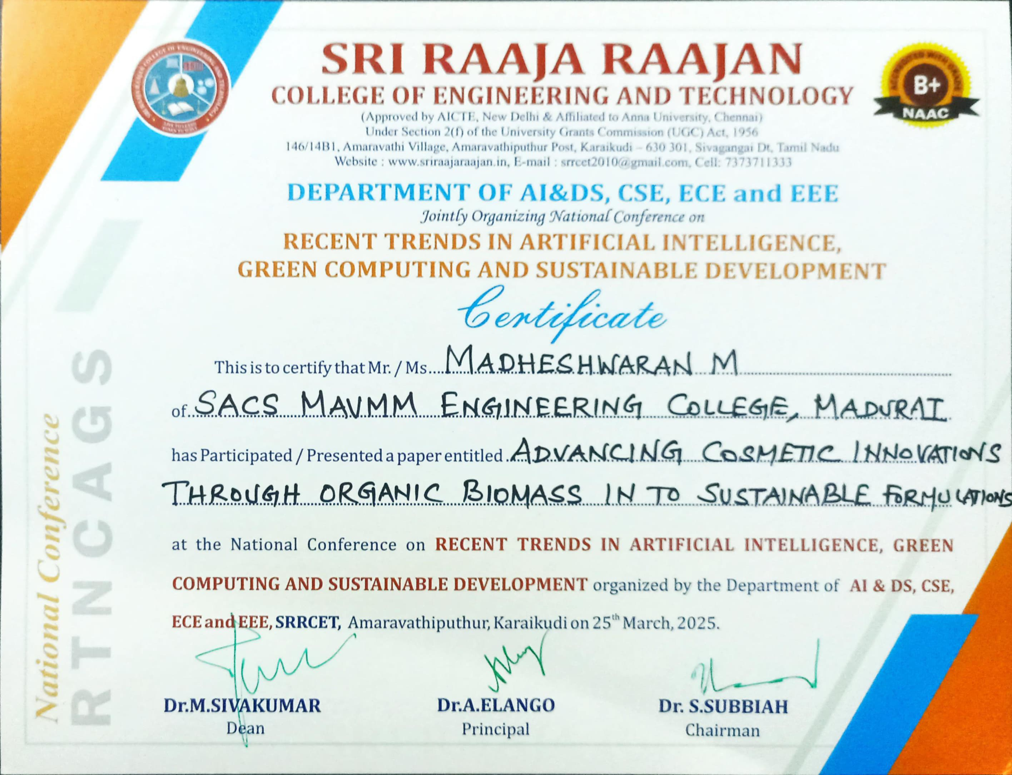
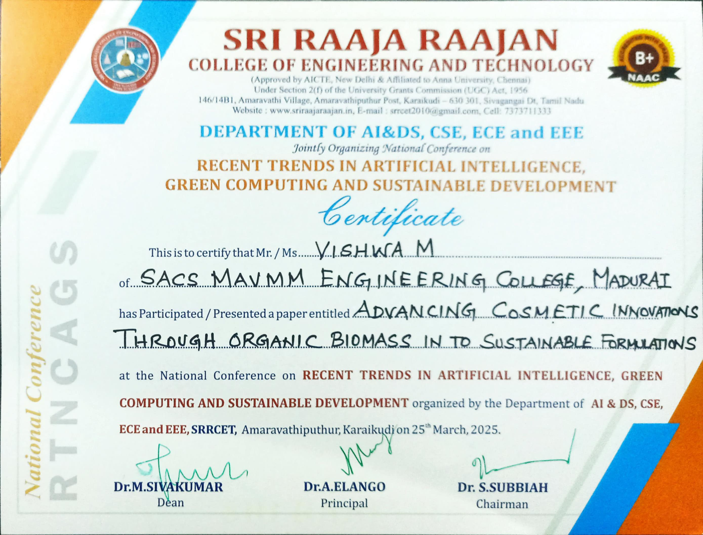
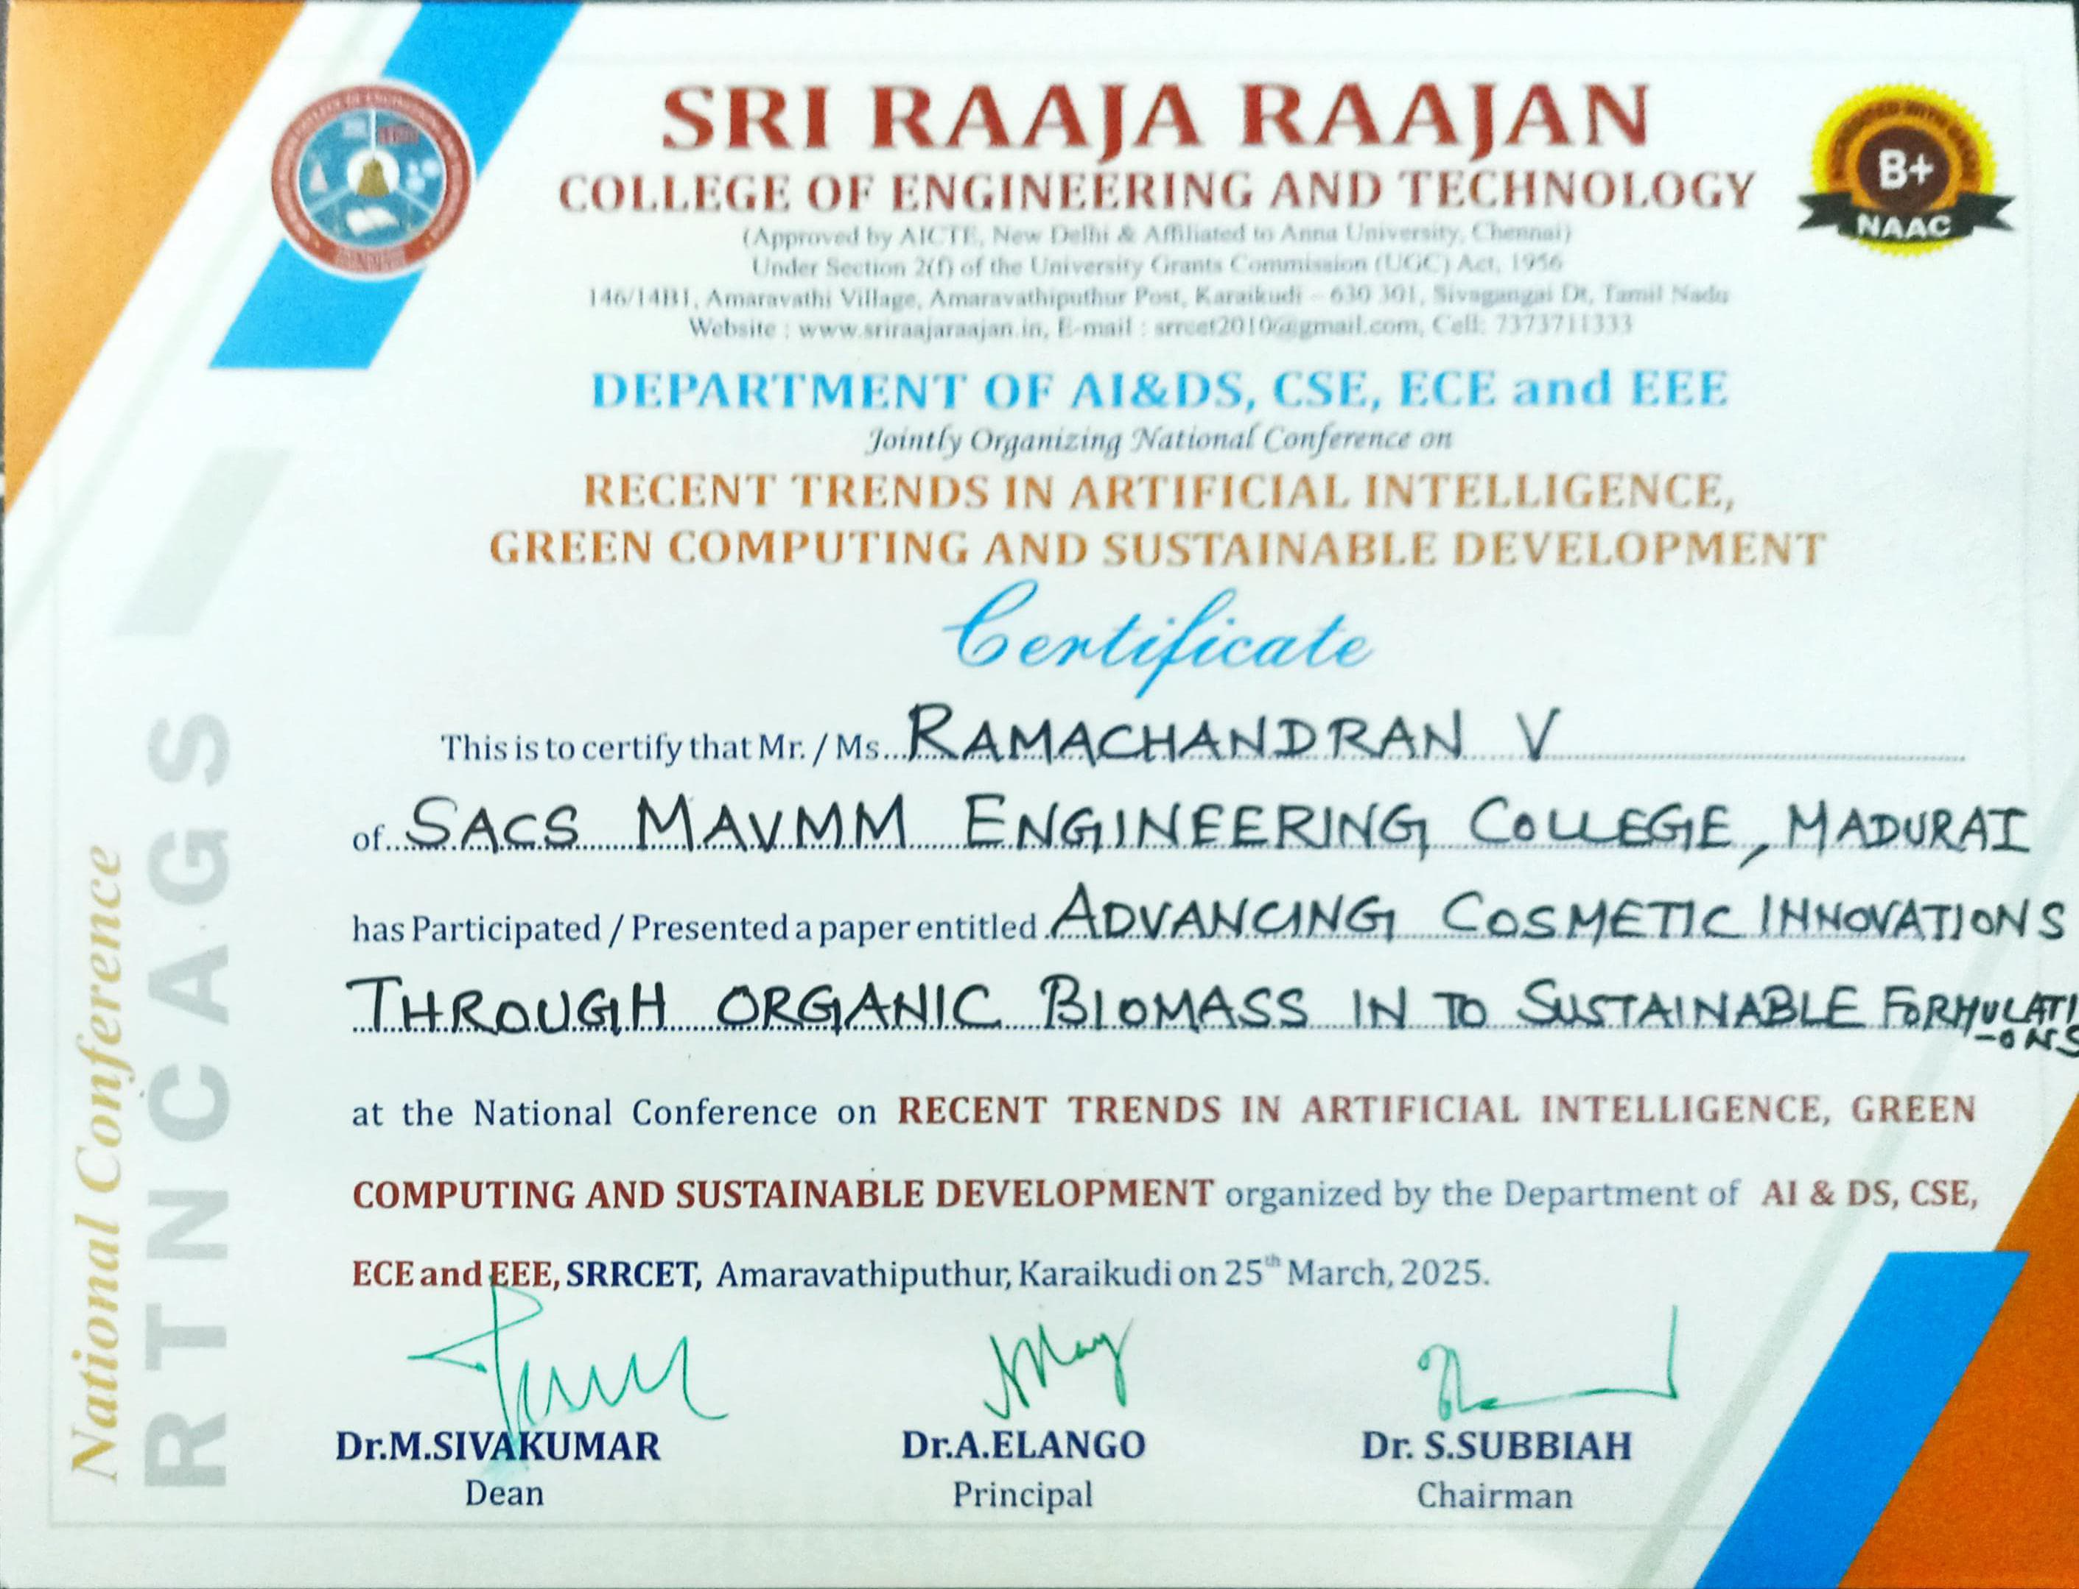
CONFERENCE CERTIFICATES

Slide 33
REFERENCES
[1] B. McMahan, E. Moore, D. Ramage, S. Hampson, and B. A. Y. Arcas,“Communication-efficient learning of deep networks from decentralized data,” in Proc. Int. Conf. Artif. Intell. Stat., Apr. 2017, pp. 1273–1282.
[2] P. Kairouz et al., “Advances and open problems in federated learning, ”Found. Trends Mach. Learn., vol. 14, no. 1, pp. 1–76, 2021.
[3]F.Sattler,S.Wiedemann,K.-R.Müller,andW.Samek,“Robustandcommunication-efficient federated learning from non-i.i.d. Data,” IEEE Trans. Neural Netw. Learn. Syst., vol. 31, no. 9, pp. 3400–3413,Sep. 2020.
[4] F. Sattler, K.-R. Müller, and W. Samek, “Clustered federated learning:Model-agnostic distributed multitask optimization under privacyconstraints,” IEEE Trans. Neural Netw. Learn. Syst., vol. 32, no. 8,pp. 3710–3722, Aug. 2021.
[5] N. Rieke et al., “The future of digital health with federated learning,”NPJDigit.Med.,vol.3,no.1,pp.1–7,2020.

